Slide 1
Techniques And Technologies in Variability Management:
From Conditional Compilation, Frame Technology, Framed Aspects, Lightweight Method Towards In-Code Complexity Assessable Constructs

Slide 2
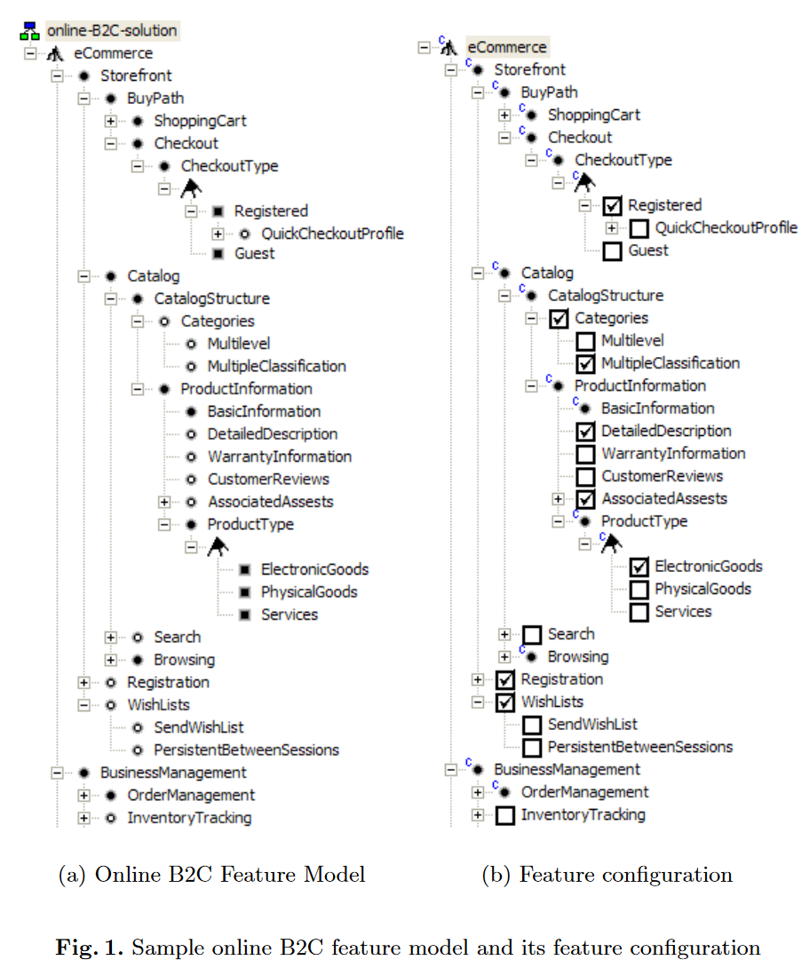
Feature Configuration
Source: Krzysztof Czarnecki and Michał Antkiewicz. ‘‘Map-ping Features to Models: A Template Approach Basedon Superimposed Variants’’. en. In: Generative Pro-gramming and Component Engineering. Ed. by DavidHutchison et al. Vol. 3676. Series Title: Lecture Notesin Computer Science. Berlin, Heidelberg: SpringerBerlin Heidelberg, 2005, pp. 422–437.

Slide 3
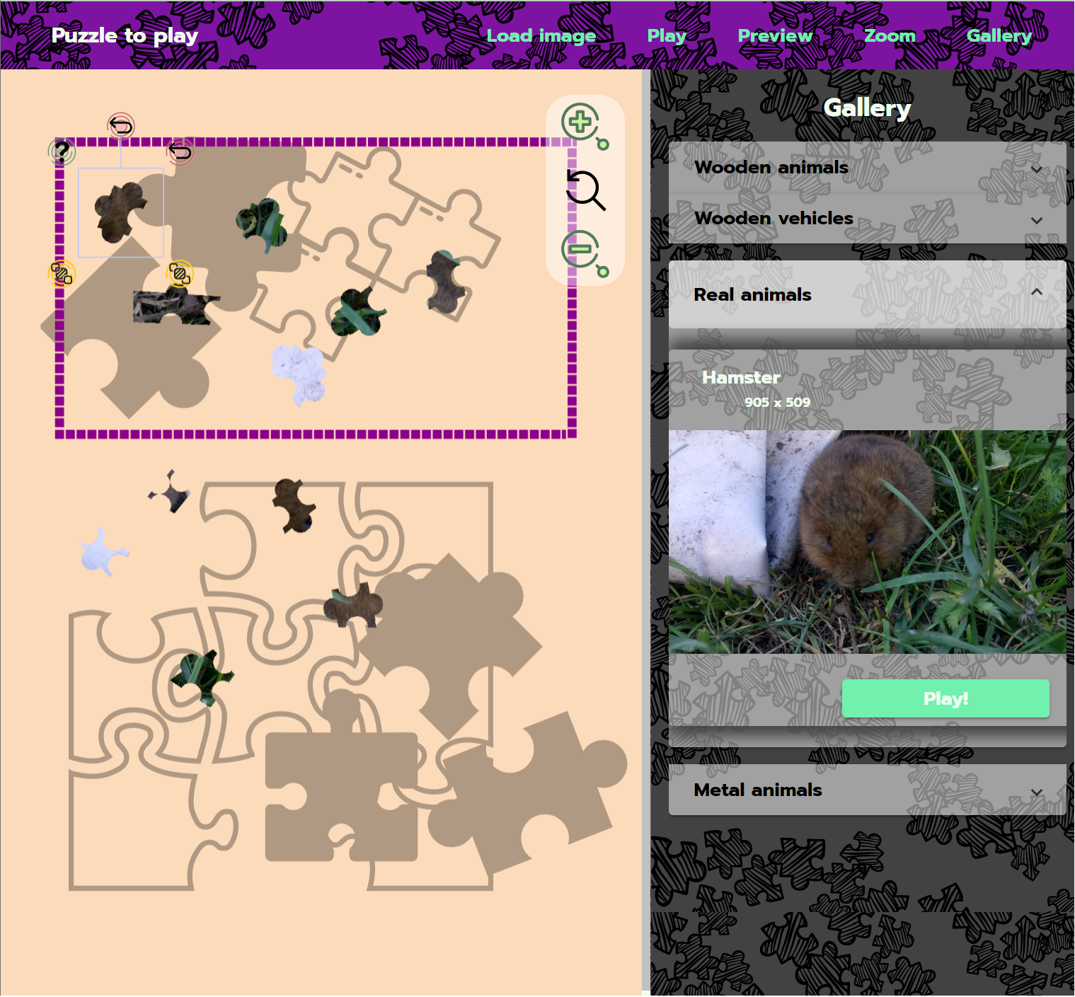
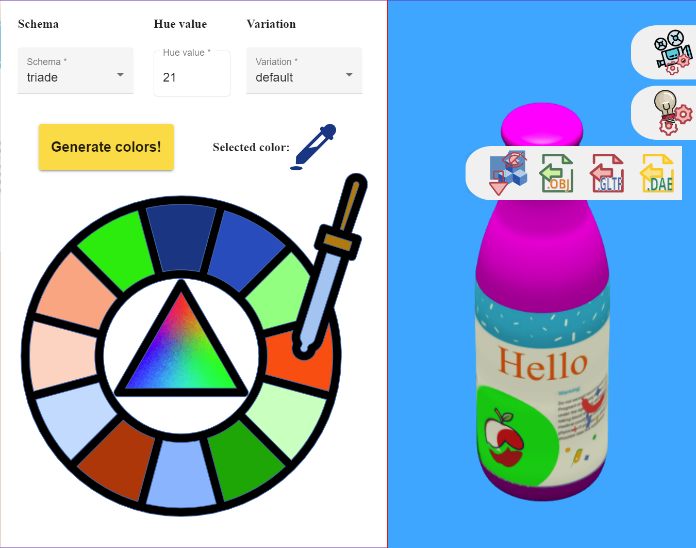
Software product lines
NO ASPECTS
IN PRODUCTS

Slide 4
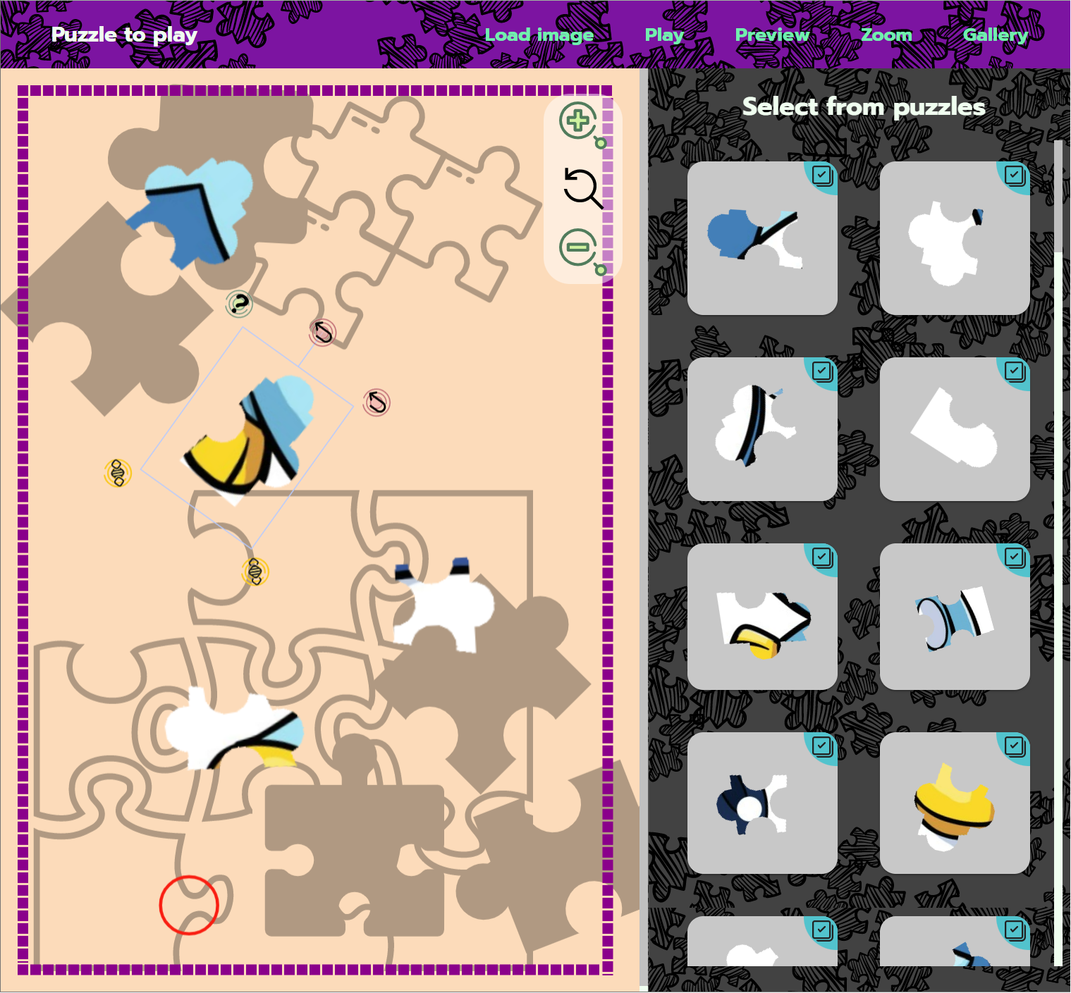
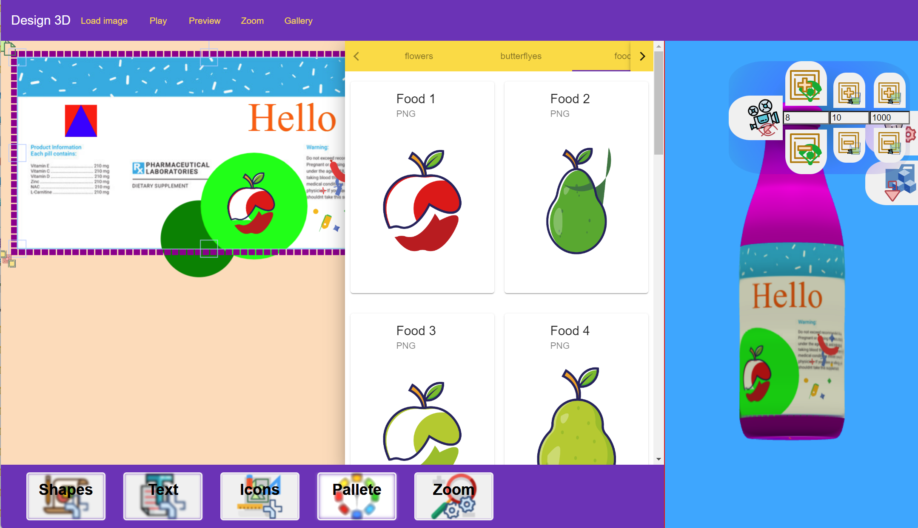
Commonality
vs. Variability
Puzzle app.
vs.
Desing app.

Slide 5
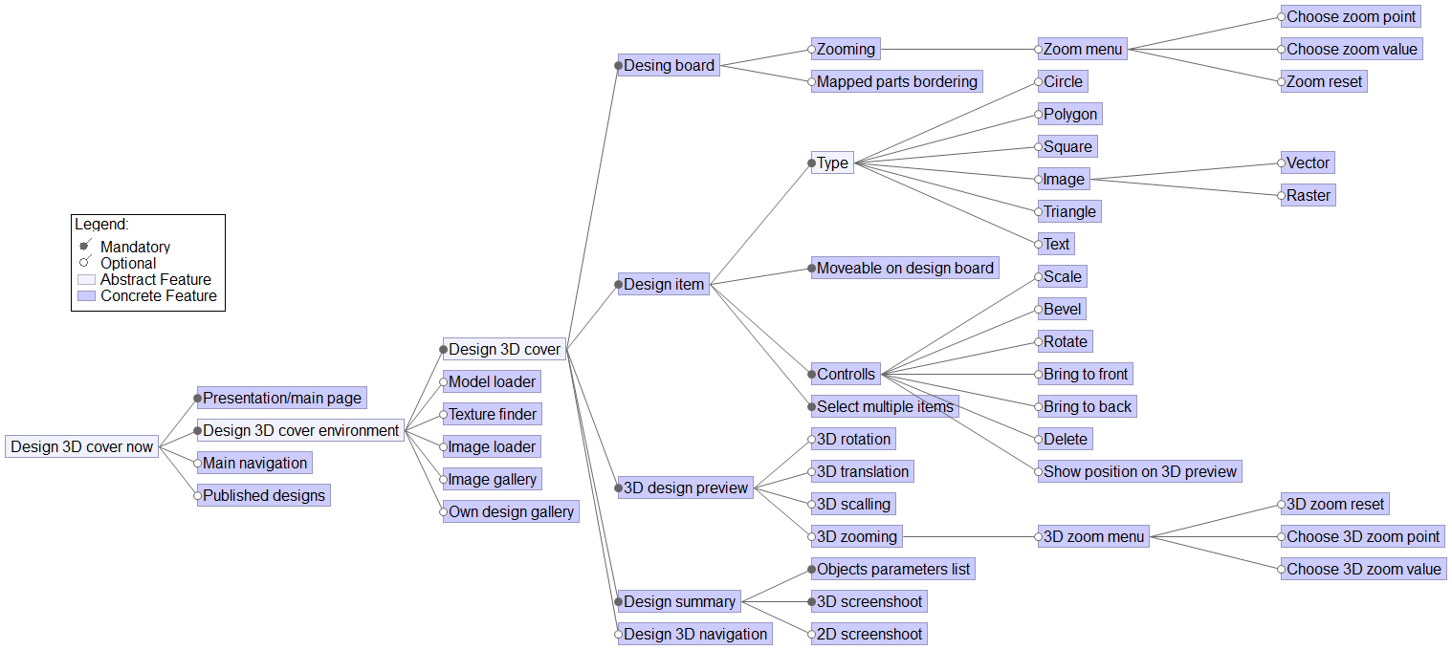
Design 3D

Slide 6
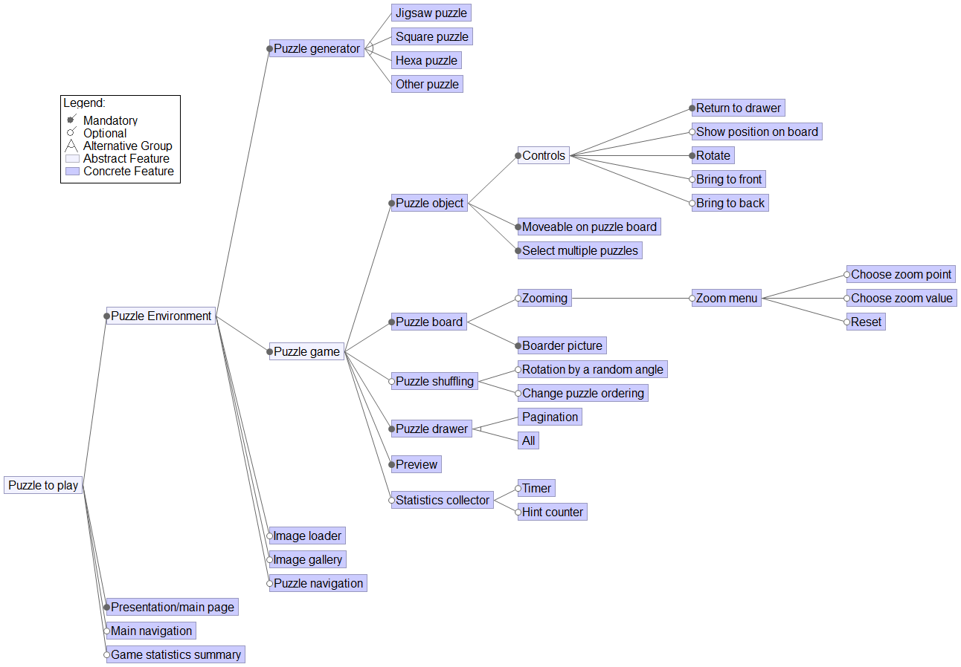
Puzzle
To Play

Slide 7
Combining both of their platforms?
-often realized in automobile industry
-users wants all features to
make final design as good as possible
FOR REUSE
-majority of changes
are necessary for the new
type of product
-platform fits best for developing
new algorithms
and for its interactions
Software Product Line to Produce
Stateful Canvas Software Products

Slide 8
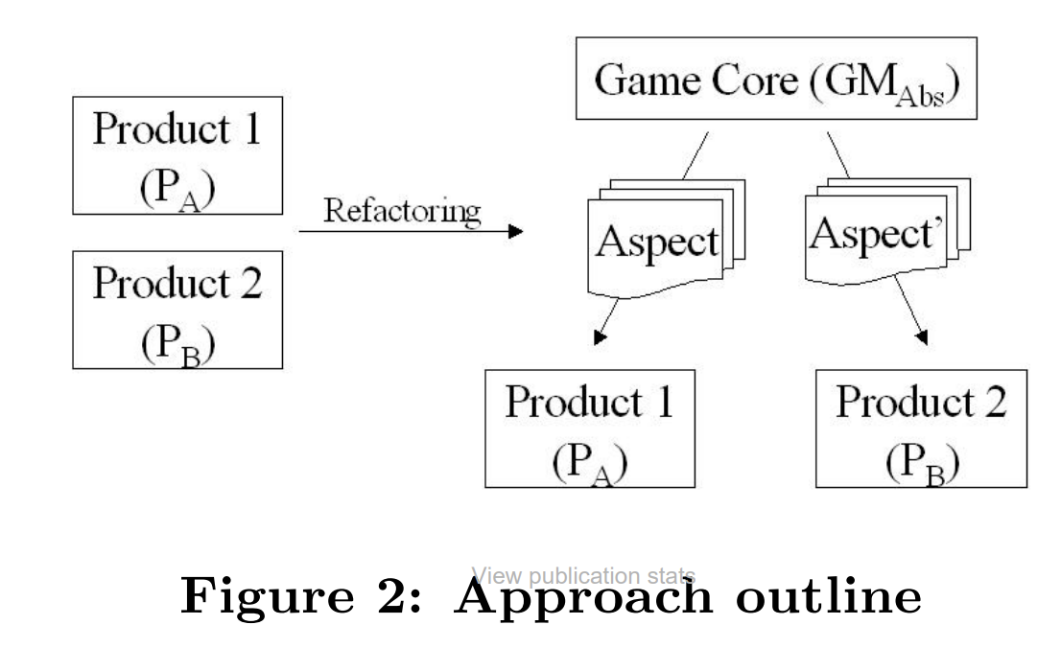
Aspect-Oriented Product Lines: Approach
Source: Alves, V., Jr, P.M., Borba, P.: An Incremental Aspect-Oriented
ProductLine Method for J2ME Game Development p. 3 (Jan 2004)

Slide 9
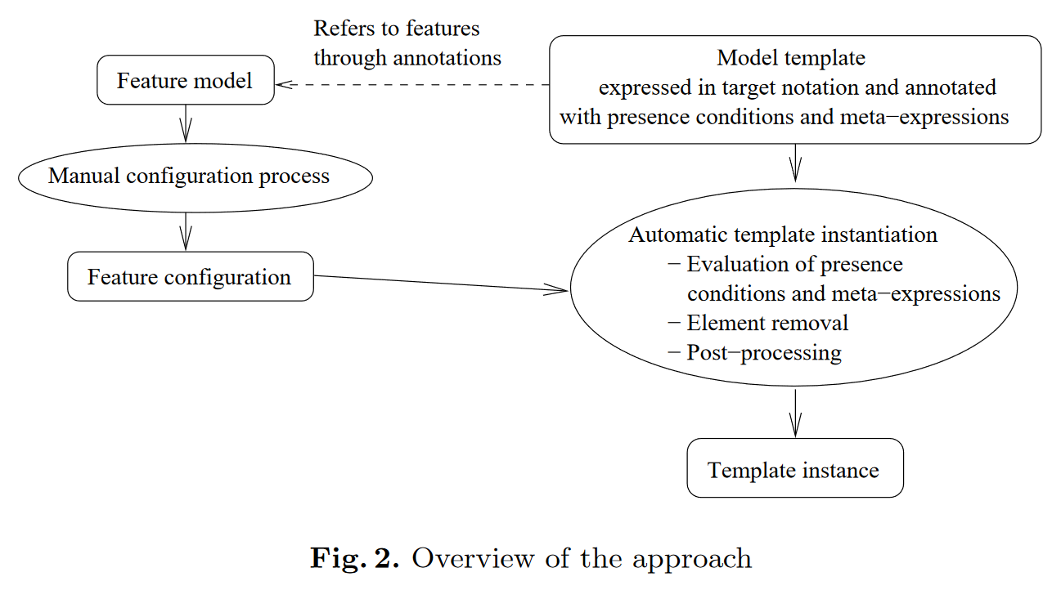
Superimposed variants
Specifies instance
of model family
Based on feature model
Automation based on this configuration
Source: Krzysztof Czarnecki and Michał Antkiewicz. ‘‘Map-ping Features to Models: A Template Approach Basedon Superimposed Variants’’. en. In: Generative Pro-gramming and Component Engineering. Ed. by DavidHutchison et al. Vol. 3676. Series Title: Lecture Notesin Computer Science. Berlin, Heidelberg: SpringerBerlin Heidelberg, 2005, pp. 422–437.
Instantiation =
Model To Model
Transformation
-input and output in target notation
Similar to product
derivation

Slide 10
Variability Model
Model
Model
Template
Feature
Model
-union of model elements to make valid template instance
Model template
elements
-hierarchic organization of features with constraints on their possible configuration
-defined in terms of feature and feature attributes from feature model
annotated with
-evaluated in respect to feature configuration
Meta
Expressions
Source: Krzysztof Czarnecki and Michał Antkiewicz. ‘‘Map-ping Features to Models: A Template Approach Basedon Superimposed Variants’’. en. In: Generative Pro-gramming and Component Engineering. Ed. by DavidHutchison et al. Vol. 3676. Series Title: Lecture Notesin Computer Science. Berlin, Heidelberg: SpringerBerlin Heidelberg, 2005, pp. 422–437.
Presence
Conditions
-used to compute attributes of model elements
-attached to model instance to state if element is present (condition is evaluated as false) or should be removed (false)
-element name, return type of operation,...
Boolean formulas correspond to the features in feature model

Slide 11
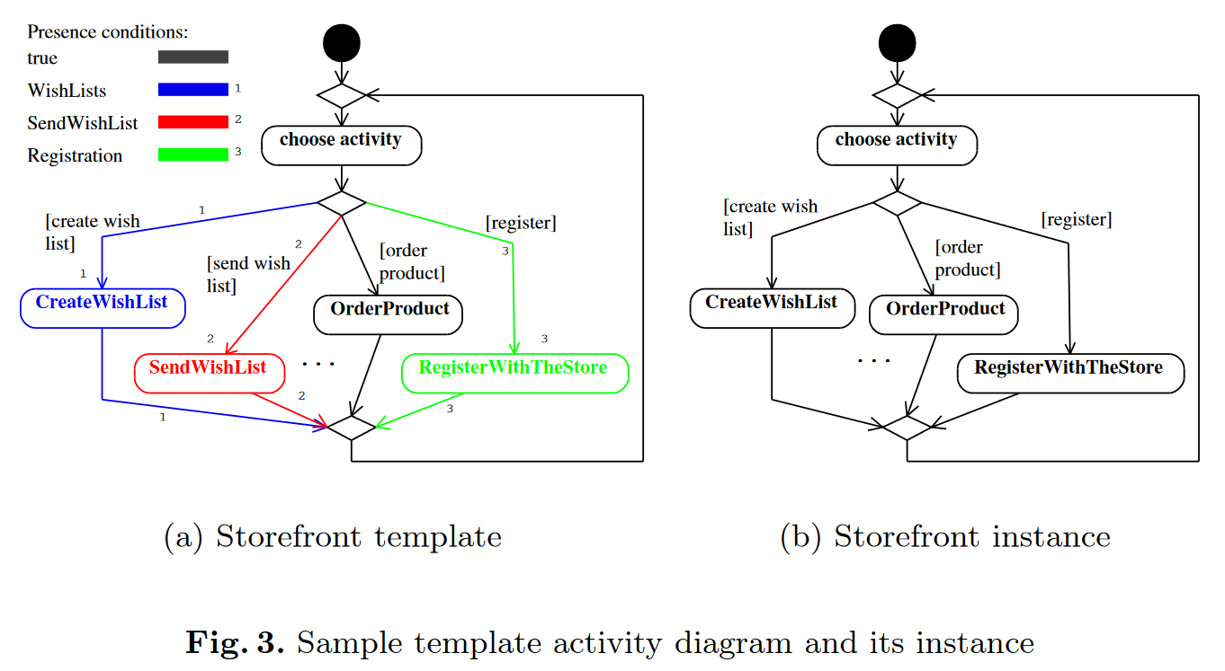
Superimposed Variants: Example
Top-level activity of store-front
commonality
variability
Container (whole model)
is managed with its own
presence conditions. All
elements are removed
along with removed
container.
instantiation (also
derivation in SPL context)
SendWishList not included
– as false in configuration
Applicable on XPATH if evaluates
on Boolean expression.

Slide 12
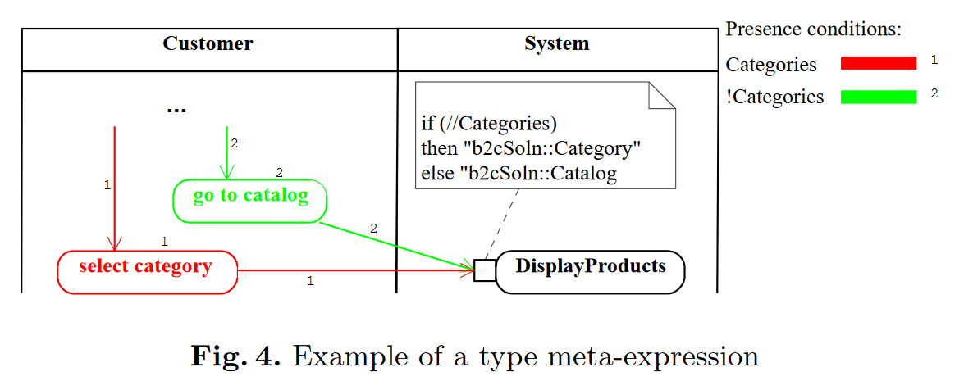
Meta-Expression in Superimposed Variants
Source: Krzysztof Czarnecki and Michał Antkiewicz. ‘‘Map-ping Features to Models: A Template Approach Basedon Superimposed Variants’’. en. In: Generative Pro-gramming and Component Engineering. Ed. by DavidHutchison et al. Vol. 3676. Series Title: Lecture Notesin Computer Science. Berlin, Heidelberg: SpringerBerlin Heidelberg, 2005, pp. 422–437.
Input pin
of action

Slide 13
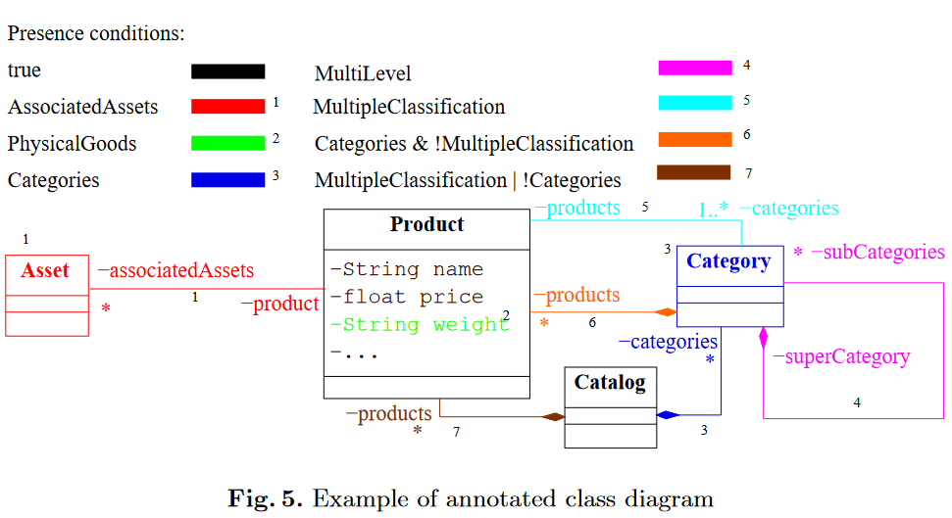
Class Diagram
Containment hierarchy
for Category
Classification of
product into
multiple
categories
Source: Krzysztof Czarnecki and Michał Antkiewicz. ‘‘Map-ping Features to Models: A Template Approach Basedon Superimposed Variants’’. en. In: Generative Pro-gramming and Component Engineering. Ed. by DavidHutchison et al. Vol. 3676. Series Title: Lecture Notesin Computer Science. Berlin, Heidelberg: Springer Berlin Heidelberg, 2005, pp. 422–437.

Slide 14
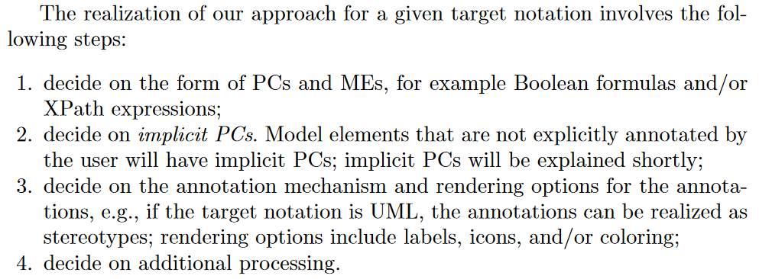
Superimposed Variants: Approach Steps

Slide 15
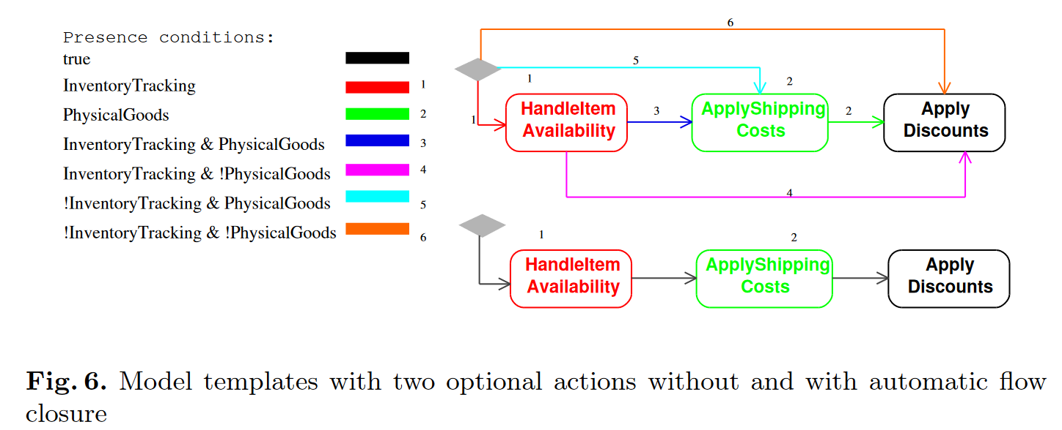
Meta-Expression in Superimposed Variants

Slide 16
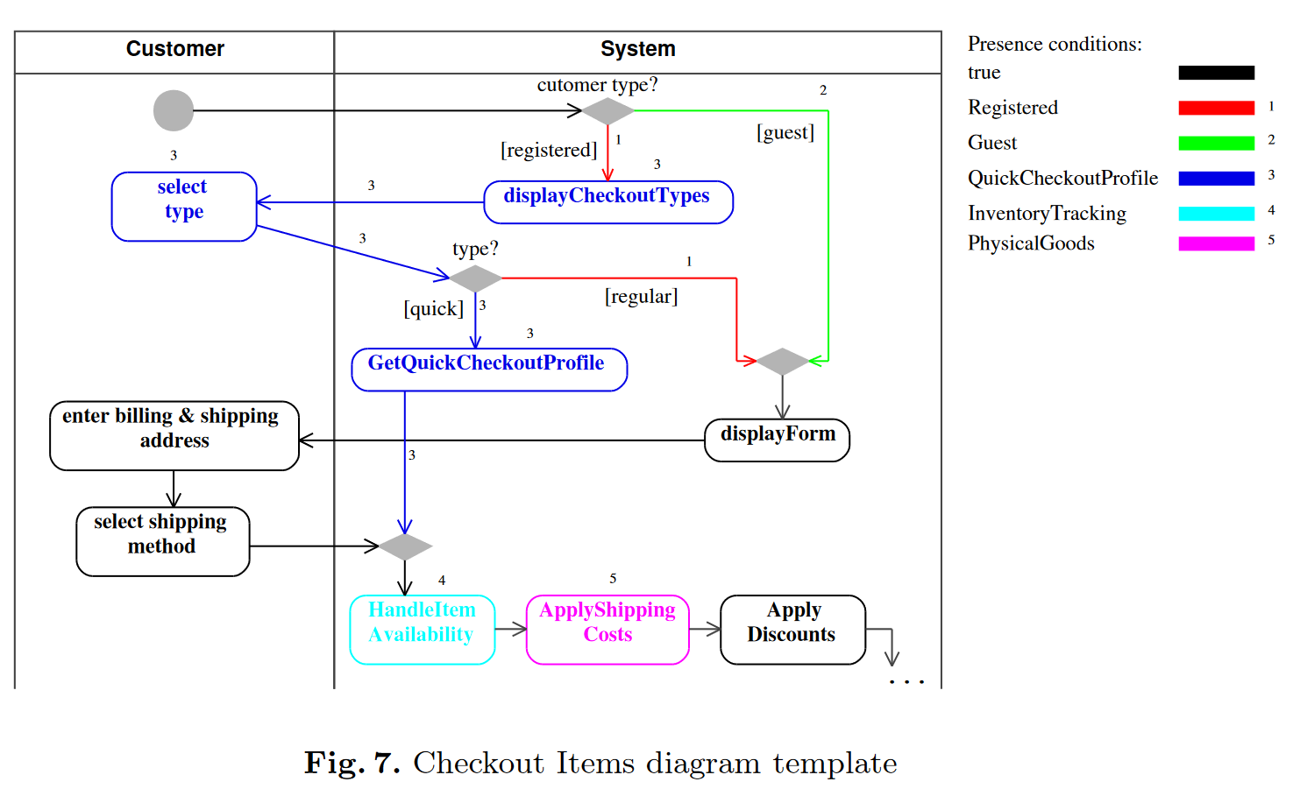

Slide 17
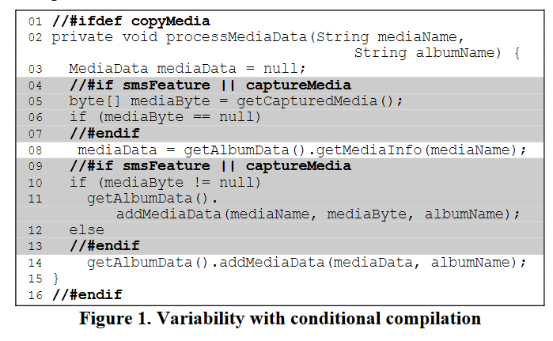
Conditional Compilation
Variability Block 2
Config.
Expressions:
Variability
Block 1
smsFeature ||
captureMedia
Config.
Expressions:
Variability
Block 3
copyMedia
Config. Expressions:
smsFeature ||
captureMedia
Figueiredo, E., Cacho, N., Sant’Anna,
C., Monteiro, M., Kulesza: Evolving software product lines with aspects: An empirical study on
design stability. In: Proceedings of 30th international conference on Software
engineering, ICSE’08. ACM (2008)

Slide 18
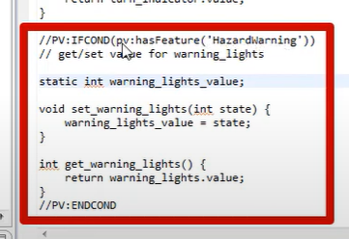
Wrappers in pure::variants
from: pure::systems: PLE & code—managing
variability in source code. https: //youtu.be/RlUYjWhJFkM (2020)

Slide 19
Configuration expression in pure::variants
Expression:
Whole variability construct:
from: pure::systems: PLE & code—managing
variability in source code. https: //youtu.be/RlUYjWhJFkM (2020)

Slide 20
Framed Technology - Overview
From 1970s
Language independent textual preprocessor
To create generalized components
Easily adapted or modified to different reuse contexts
Based on code templates and specification from developers
Typical Commands/Tags:
<set> - sets a variable
<select> - selects an option
<adapt> - refines a module with new functionality
<while> - creates a loop around repeating code

Slide 21
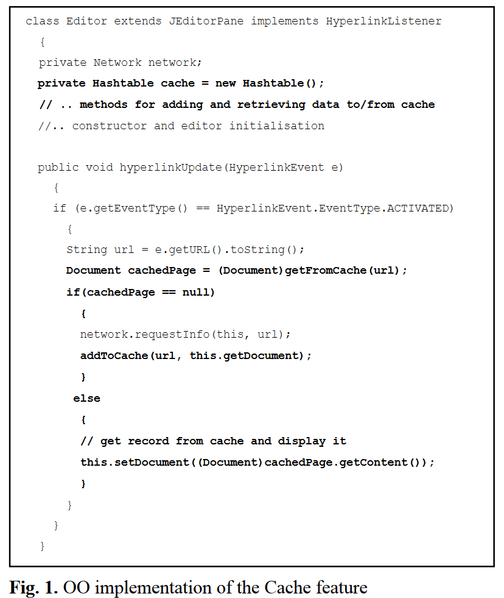
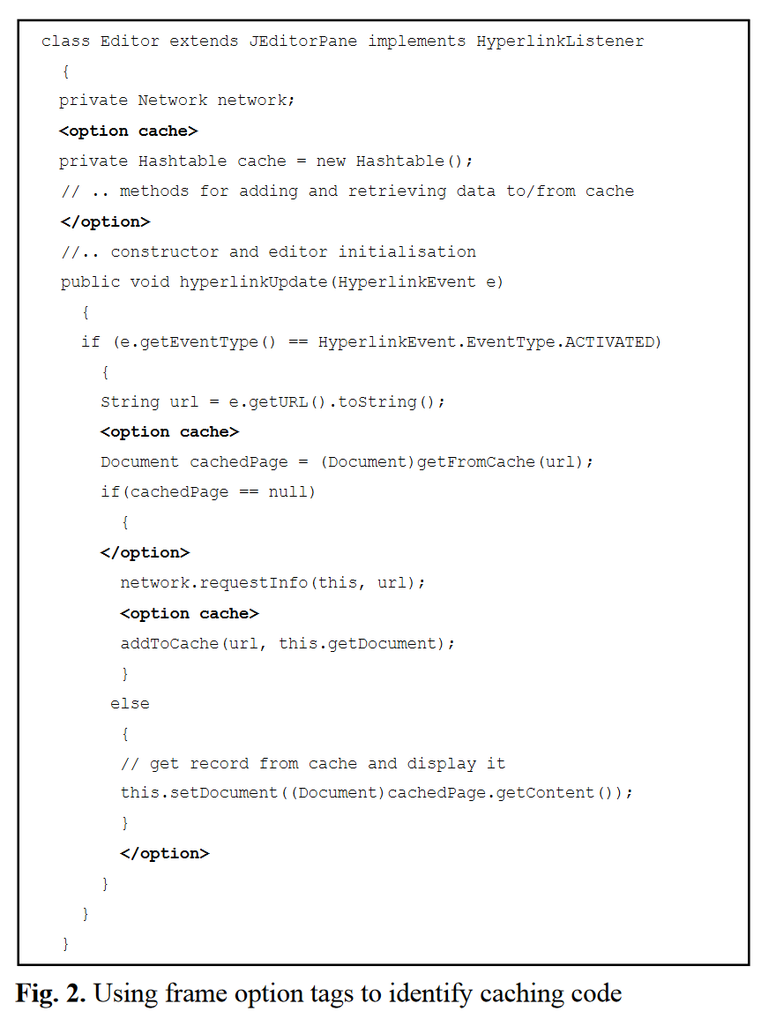
pertaining to
the hyperlinkEvent
requires to
update code
in both frames
Single System
Code – OOP
implementation
Framed
Technology –
variability
handled code
Source: Loughran, N., Rashid, A., Zhang, W., Jarzabek, S.: Supporting product line
evolution with framed aspects p. 5 (2004)

Slide 22
Framed Technology - OOP
Implementation of cache feature using
object-oriented programming
Source: Loughran, N., Rashid, A., Zhang, W., Jarzabek, S.: Supporting product line
evolution with framed aspects p. 5 (2004)

Slide 23
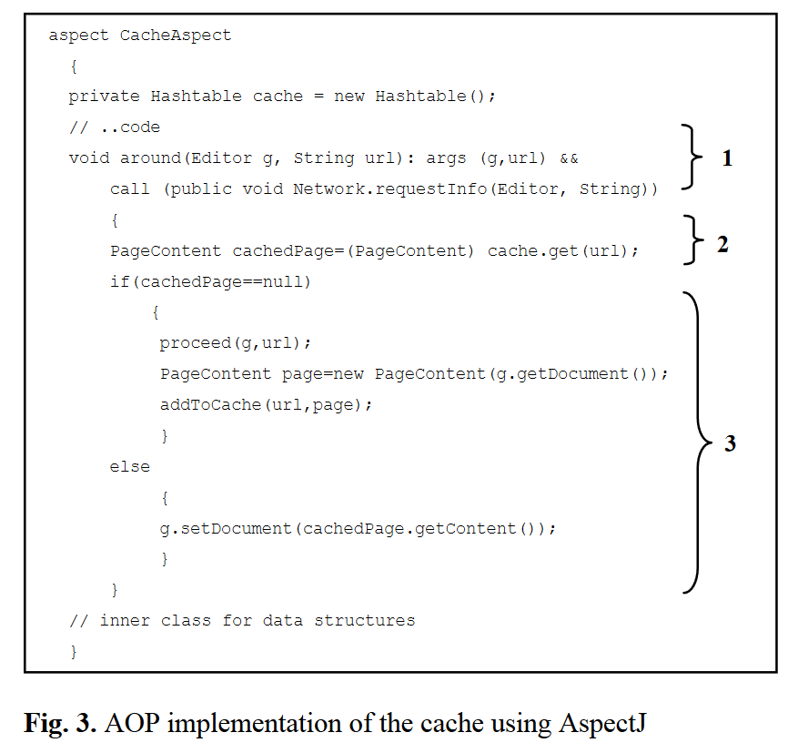
Framed Technology - AOP
Implementation of cache feature using
aspect-oriented programming
UNAVAILABLE PARAMETERIZATION
SUPPORT WITH PURE
ASPECT-ORIENTED PROGRAMMING
Abstract aspects
+
Concreate aspects
(specifying concrete
variants)
-can lead to
inheritance
annomalies
Source: Loughran, N., Rashid, A., Zhang, W., Jarzabek, S.: Supporting product line
evolution with framed aspects p. 5 (2004)

Slide 24
Framed Technology With Aspects
-benefitting from the combination of Frame technology and aspects
-processed by Lancaster Frame Processor (LFP)
[which is essentially a cut down
version of the XVCL frame processor]
RESTRICTIONS:
-takes only selected frame constructs
-forces programmer to use aspect-oriented techniques
Aspects
Frame Technology
-to encapsulate and modularize
tangled features
-providing parameterization and reconfiguration support
for feature aspects
-reduces clutter of template code
-creation of metavariables and options bound to specification from the developer
-to support effective parameterization
and reconfiguration

Slide 25
Comparing Frames and AOP
Source: Loughran, N., Rashid, A., Zhang, W., Jarzabek, S.: Supporting product line
evolution with framed aspects p. 5 (2004)

Slide 26
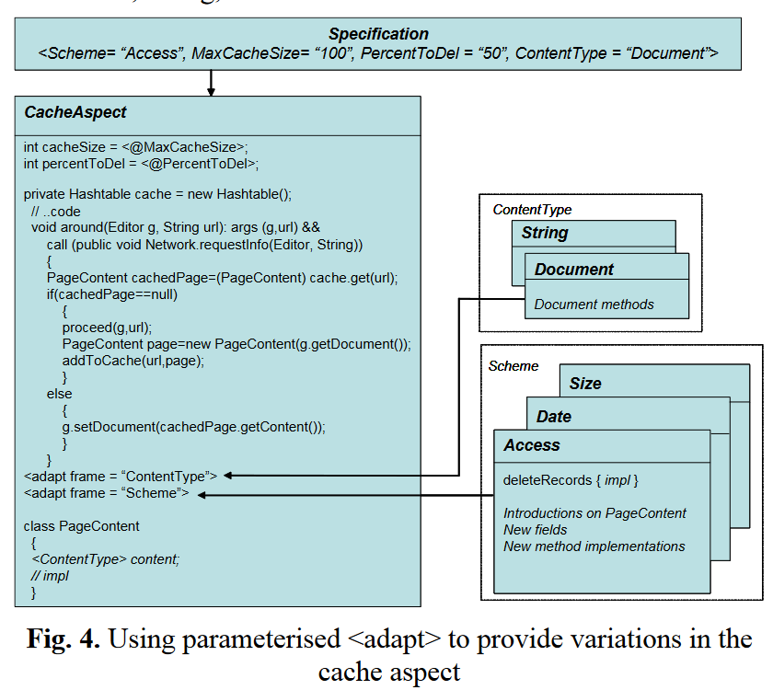
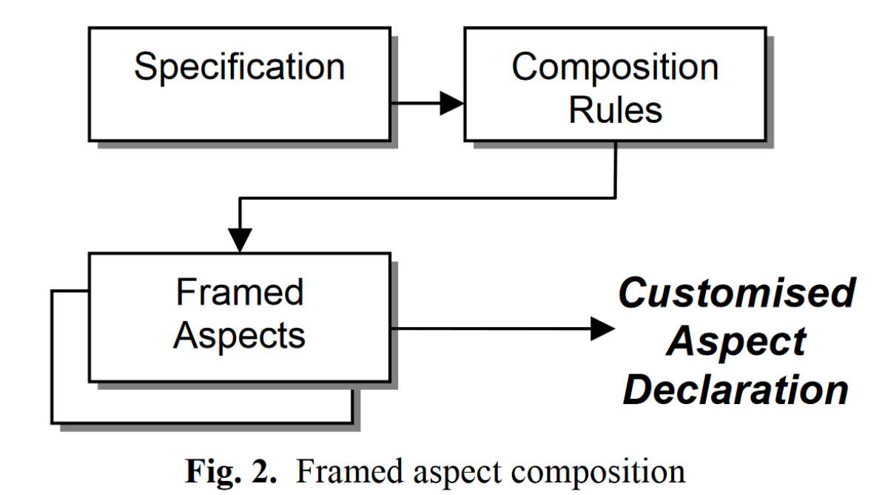
Framed Aspects
-aspects benefitting from generalization
and parameterization
-offering the best from frames and
aspects such as
-flexibility
-reusability
-evolvability
-improving the integration
of features in SPL
(crosscutting
multiple modules
in OO and frames
without aspects)
-LOCALIZATION OF
CROSSCUTTING
CONCERNS
B) MERGE ALTERNATIVE AND OPTIONAL
FEATURES IN TERMS OF CONSTRAINTS
CODE AFFECTED
WITH FRAMED TAGS
-improving system
comprehensibility
-minimising design
erosion of architectures
Source: Loughran, N., Rashid, A., Zhang, W., Jarzabek, S.: Supporting product line
evolution with framed aspects p. 5 (2004)

Slide 27
Configurable
parameters
CODE
AFFECTED
WITH
FRAMED
TAGS
Different
Strategies
(of content
type)
Assigned values from
template parameters
-to do not constrain
Aspects on J2SE
document
Different
Strategies
(of scheme)
PARAMETERIZED ADAPT:
To frame
properties
(Scheme,
ContentType)
-predefines data
structure within
cache and the
way how is deleted
+ incorporation into
aspect.
-intertype declaration
Defining type of object

Slide 28
Framed Aspects
B) MERGE ALTERNATIVE AND OPTIONAL FEATURES
IN TERMS OF CONSTRAINTS
-adapt tags from the framed aspect
code to the composition rules)
-more control over different modules
-for more complex scenarios
-removal more of invasive frame code
-the moving of option
-developed methodology to use feature
diagram based on FODA:
mapping
REUSABLE
COMPONENT
FRAME ASPECT
Source: Loughran, N., Rashid, A., Zhang, W., Jarzabek, S.: Supporting product line
evolution with framed aspects p. 5 (2004)

Slide 29
Framed Aspects Composition
Developer’s customization specifications
Maps out possible legal aspect feature:
compositions
combinations
constraints
control flows
How these
bound
together
-taking incomplete template specification + filling options and variables that are wished to set
Made of 3
distinct modules:
Normal aspect code
Framed
Aspect Code
B) Composition Rules
Parameterised aspect code (Framed Aspects)
C) Specification

Slide 30
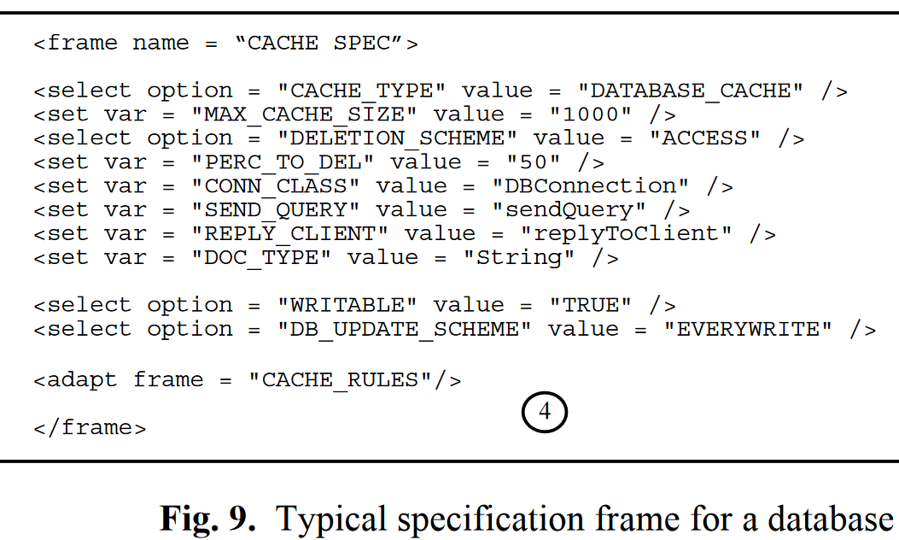
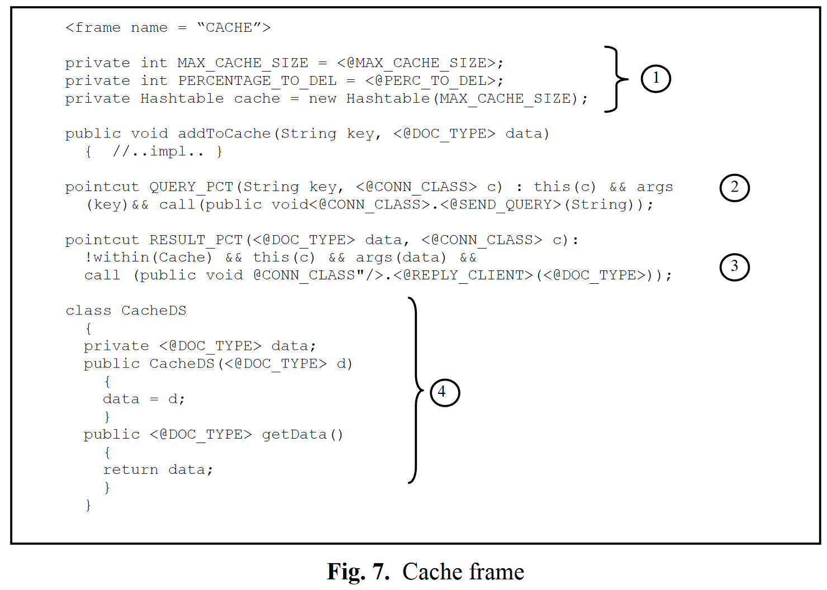
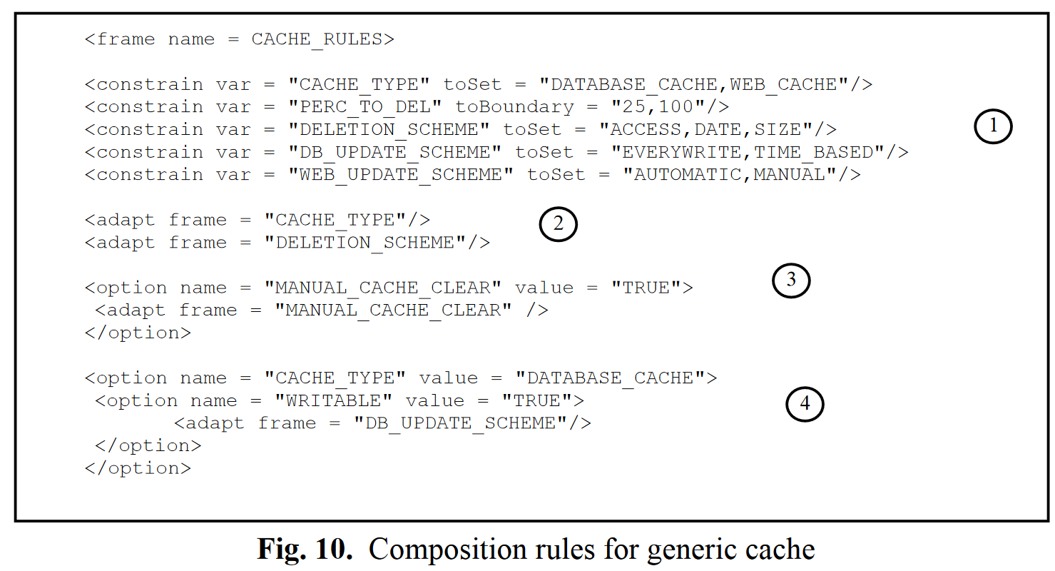
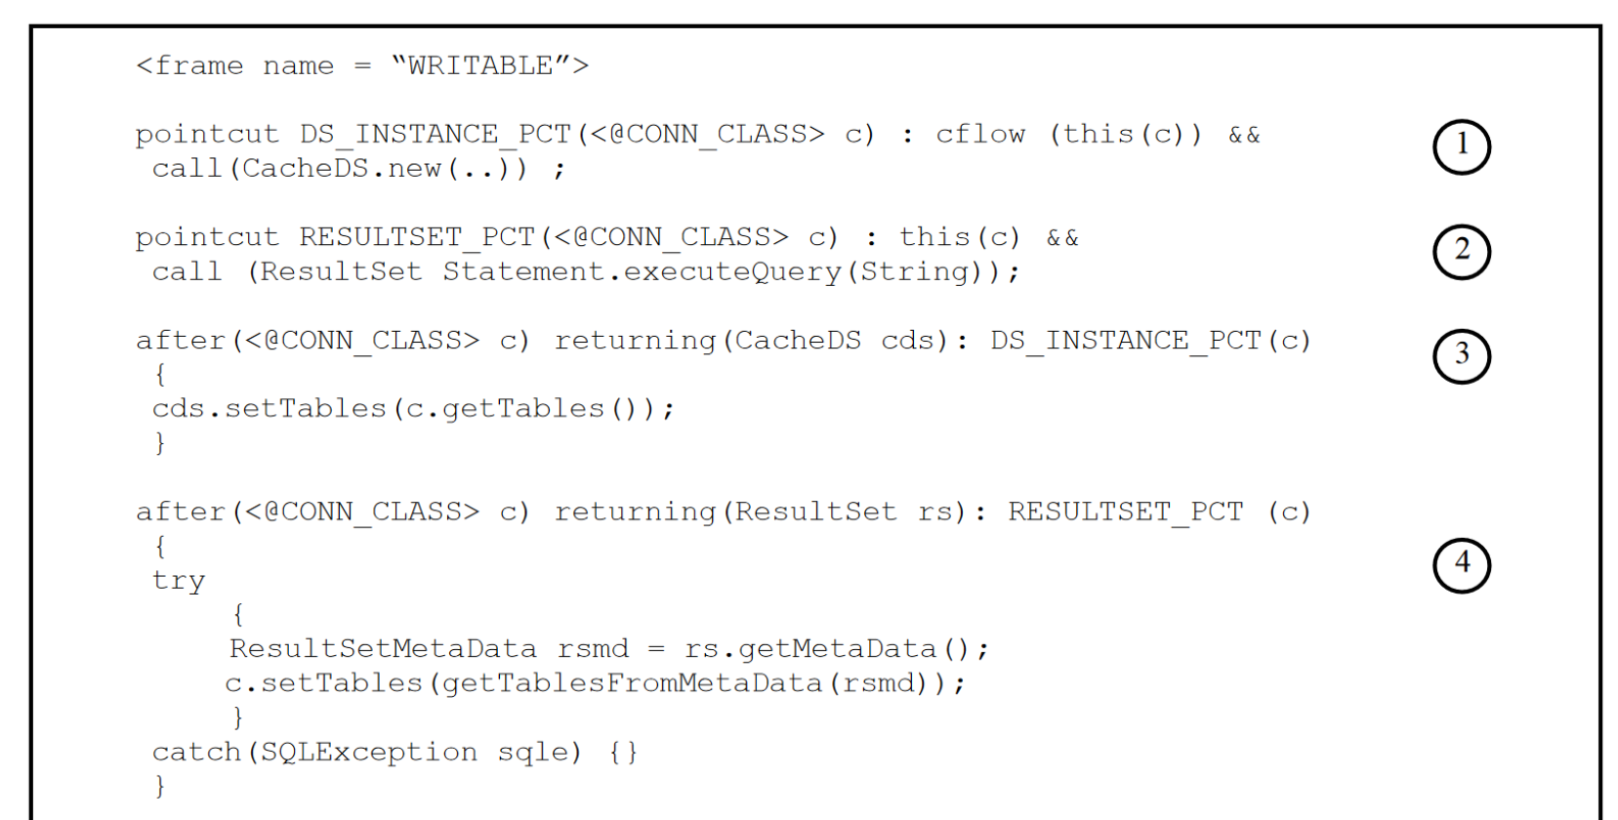
Process

Slide 31
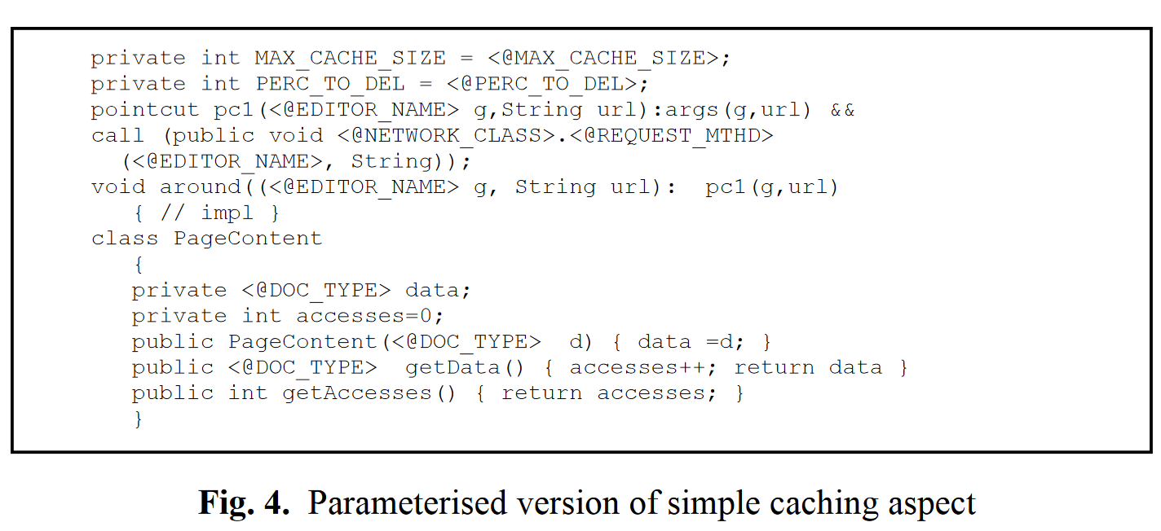
Parame-terized Variants
MAX_CACHE_SIZE: Sets the maximum size of records the cache will hold.
PERC_TO_DEL: The amount of records to delete when the deletion mechanism is invoked.
CONN_CLASS: The class which contains the methods for sending the query to the database and also sending the results back to the client.
SEND_QUERY: The method which sends the query to the database.
REPLY_CLIENT: The method which sends the result back to the client.
DOC_TYPE: The type of information that is being stored in the cache (e.g. String, Document, CachedResultSet etc.).
Loughran, N., Rashid, A.: Framed aspects: Supporting variability and configurability for AOP. In: Proceedings of 8th International Conference onSoftware Reuse, ICSR 2004. LCNS 3107, Springer, Madrid, Spain (2004)

Slide 32
-used in any textual representation to make substantiation of type or object,
a method, joinpoint, or pointcut designator

Slide 33
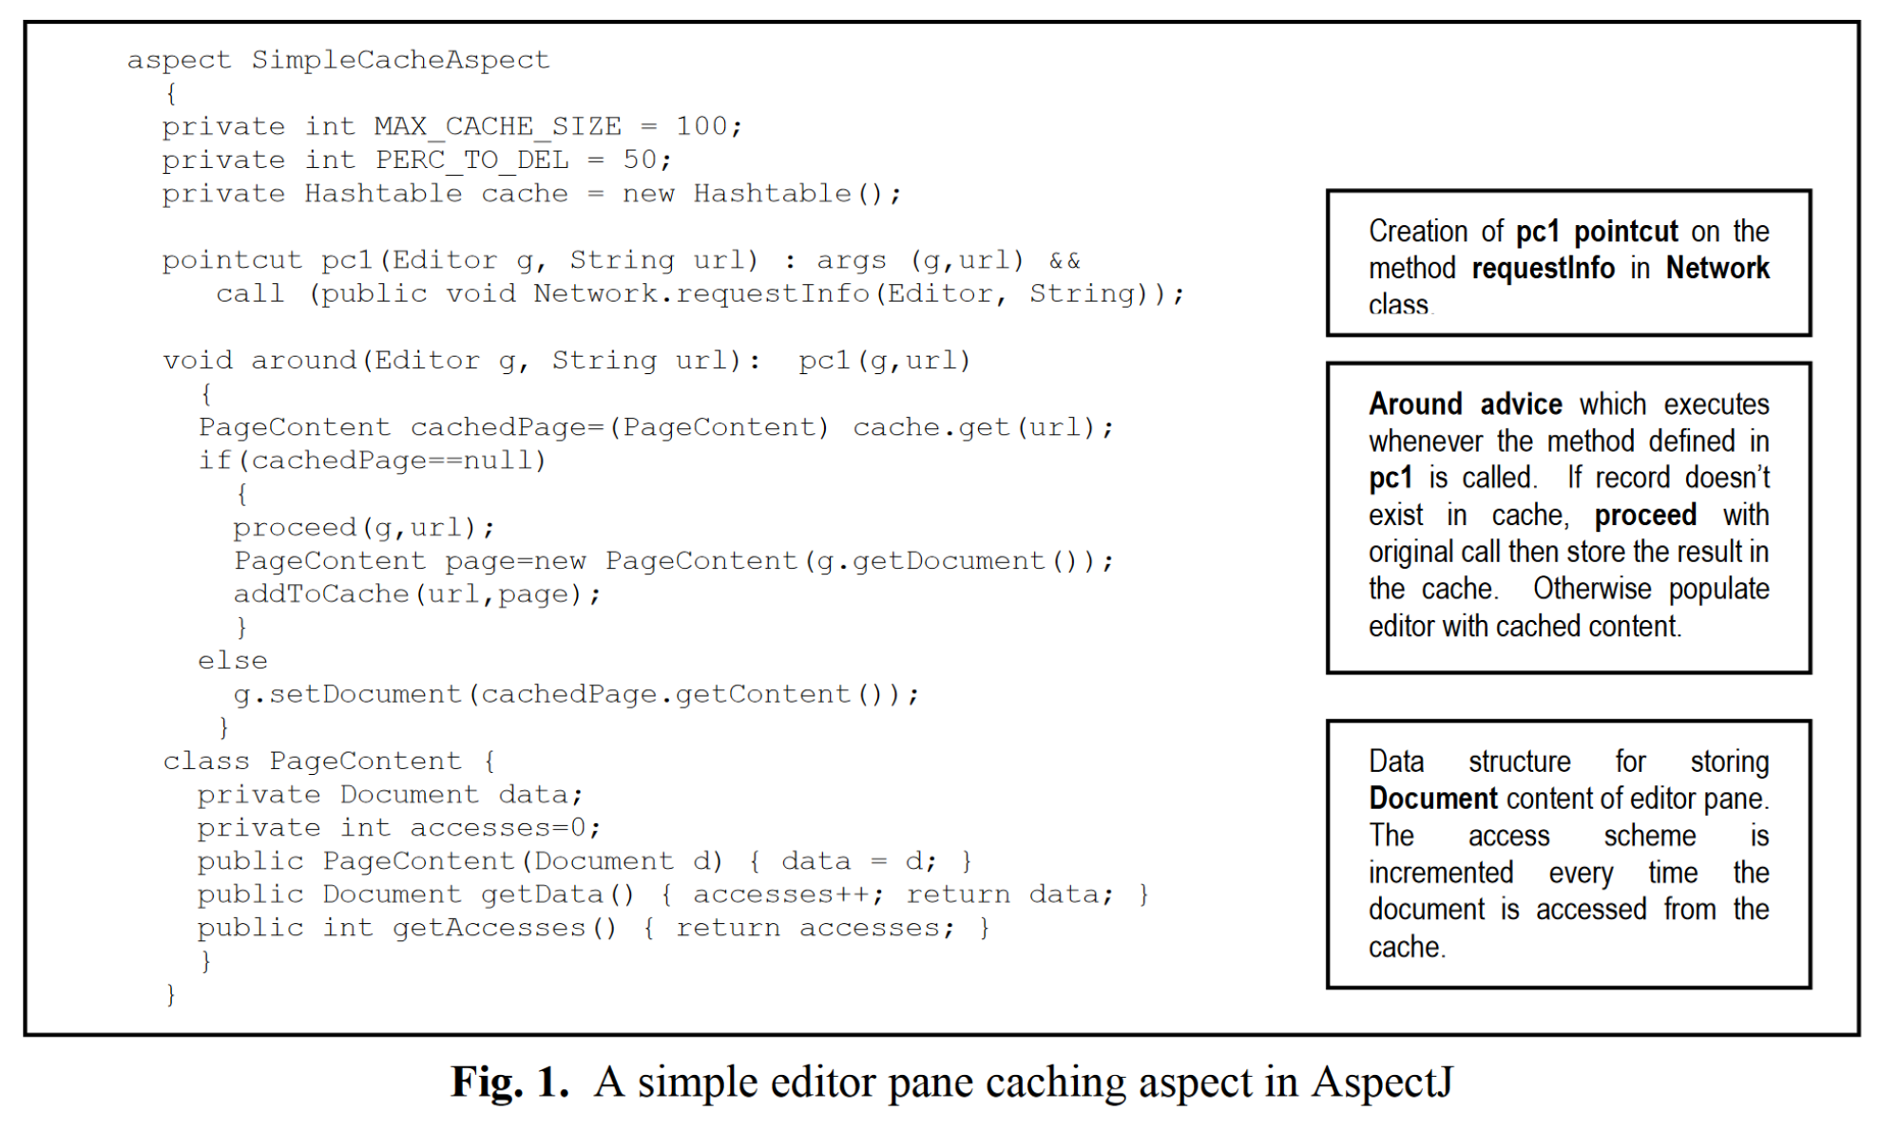
AspectJ Cache Code

Slide 34
Sets the size of the cache and percentage to be deleted as set by the parameters in the specification.
Creates a pointcut for intercepting the call to the method which executes SQL queries on the database.
Creates a pointcut for intercepting the results sent back to the client.
CacheDS is a data structure for storing the cache results.
Loughran, N., Rashid, A.: Framed aspects: Supporting variability and configurability for AOP. In: Proceedings of 8th International Conference onSoftware Reuse, ICSR 2004. LCNS 3107, Springer, Madrid, Spain (2004)

Slide 35
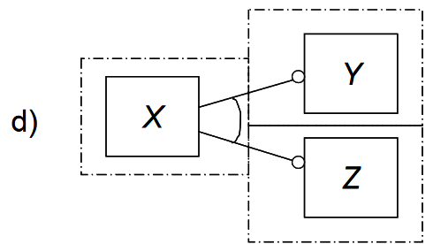
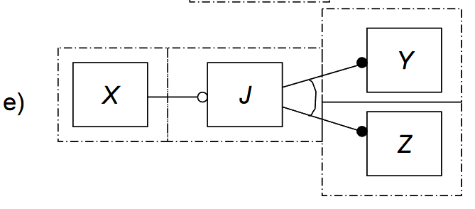
Delineating Frame Boundaries
Careful consideration of:
VARIANTS
SCOPE FOR WHICH ASPECT IS INTENDED
1) Creating feature diagram using FODA – discovering variants
Feature Approach – natural design method for use with framed aspects
Characteristics of feature aspect:
Dependencies,
Options
Alternative characteristics
2) Deducing aspects frames by delineating the boundaries between the different options and alternatives in the model
Duplicated code
common to Y and Z
(such as an algorithm)
Alternative variants
Frame
boundaries
Duplicated code
from Y and Z handled in new separate layer J

Slide 36
Delineating Frame Boundaries
Enhancing modularity and reusability
Allowing component to be framed separately from the main codebase
REUSABLE IN OTHER CONTEXTS
Breaking down large aspect modules
Hiding away less important information from the main concern
Frame
technology
Aspect Oriented Programming
Utilization of frame commands to:
fine grained variability
parameterization
Constraints
Utilization of aspect-oriented programming to:
Integrating concern in a non-invasive manner
Used to make coarser grained functionality
Used when particular concerns crosscuts multiple modules
Any programming
construct can be parameterized

Slide 37
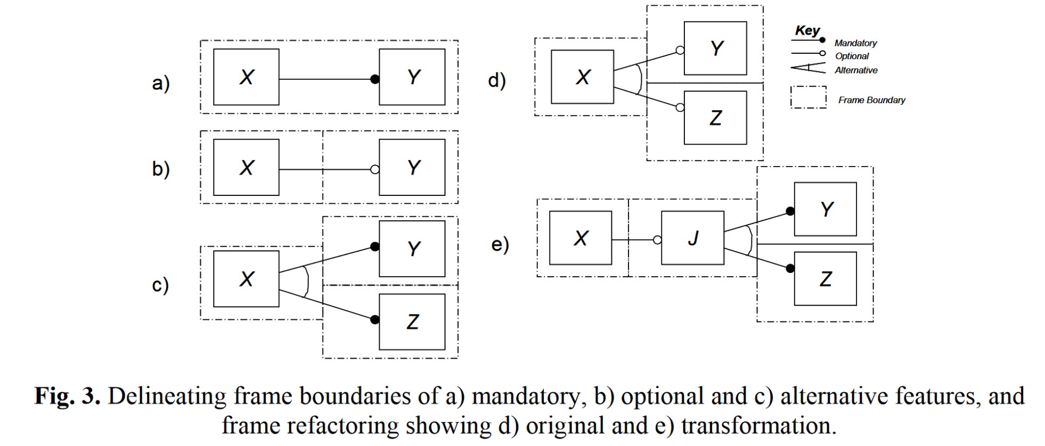
Delineating Frame Boundaries
Loughran, N., Rashid, A.: Framed aspects: Supporting variability and con-figurability for AOP.
In: Proceedings of 8th International Conference onSoftware Reuse, ICSR 2004.
LCNS 3107, Springer, Madrid, Spain (2004)
Reusability of frame with feature J

Slide 38
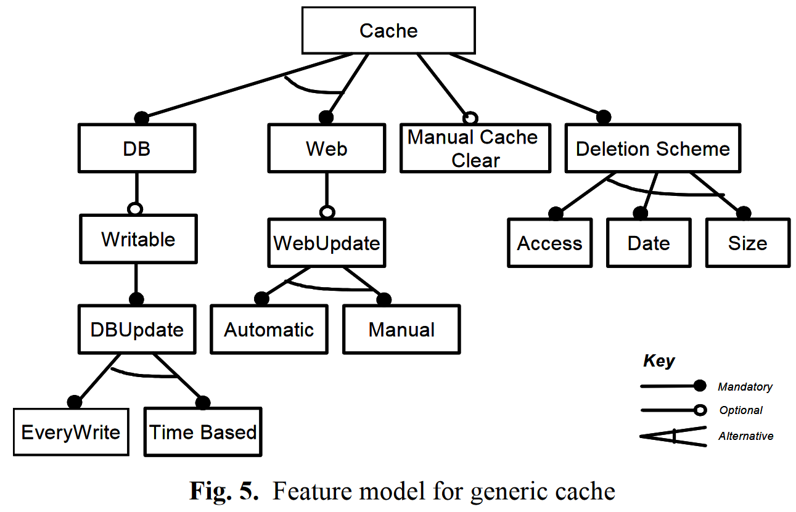
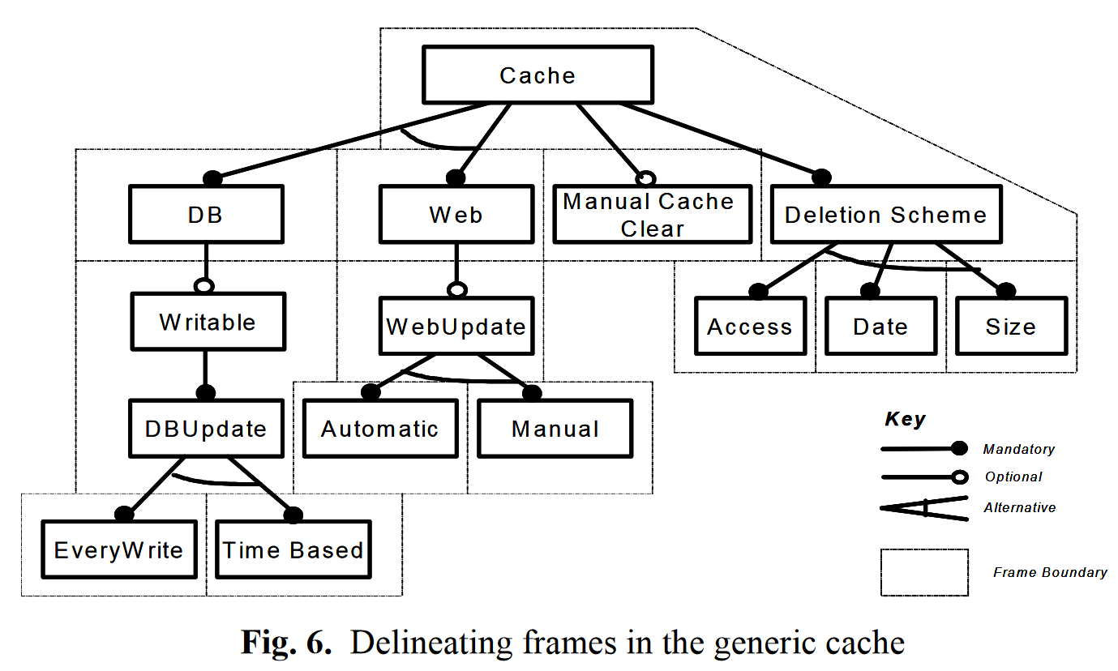
Delineating Frame Boundaries
Loughran, N., Rashid, A.: Framed aspects: Supporting variability and configurability for AOP. In: Proceedings of 8th International Conference onSoftware Reuse, ICSR 2004. LCNS 3107, Springer, Madrid, Spain (2004)

Slide 39
Writable Frame
-demonstrating strength of framed-aspects over AOP alone and frame technology:
PARAMETERIZATION AND CROSSCUTTING REFINEMENTS ARE ENCAPSULATED WITHIN SINGLE FRAME:
Pointcut used to trap new instances of CacheDS (data structure for holding the result data to be cached).
Pointcut to capture ResultSet from
currently executing query.
Advice which adds tables contained within the executing query by a particular client to the CacheDS data structure
Advice which captures the ResultSet to obtain the ResultSetMetaData and, therefore, the tables used in the resulting query.
Loughran, N., Rashid, A.: Framed aspects: Supporting variability and configurability for AOP. In: Proceedings of 8th International Conference onSoftware Reuse, ICSR 2004. LCNS 3107, Springer, Madrid, Spain (2004)

Slide 40
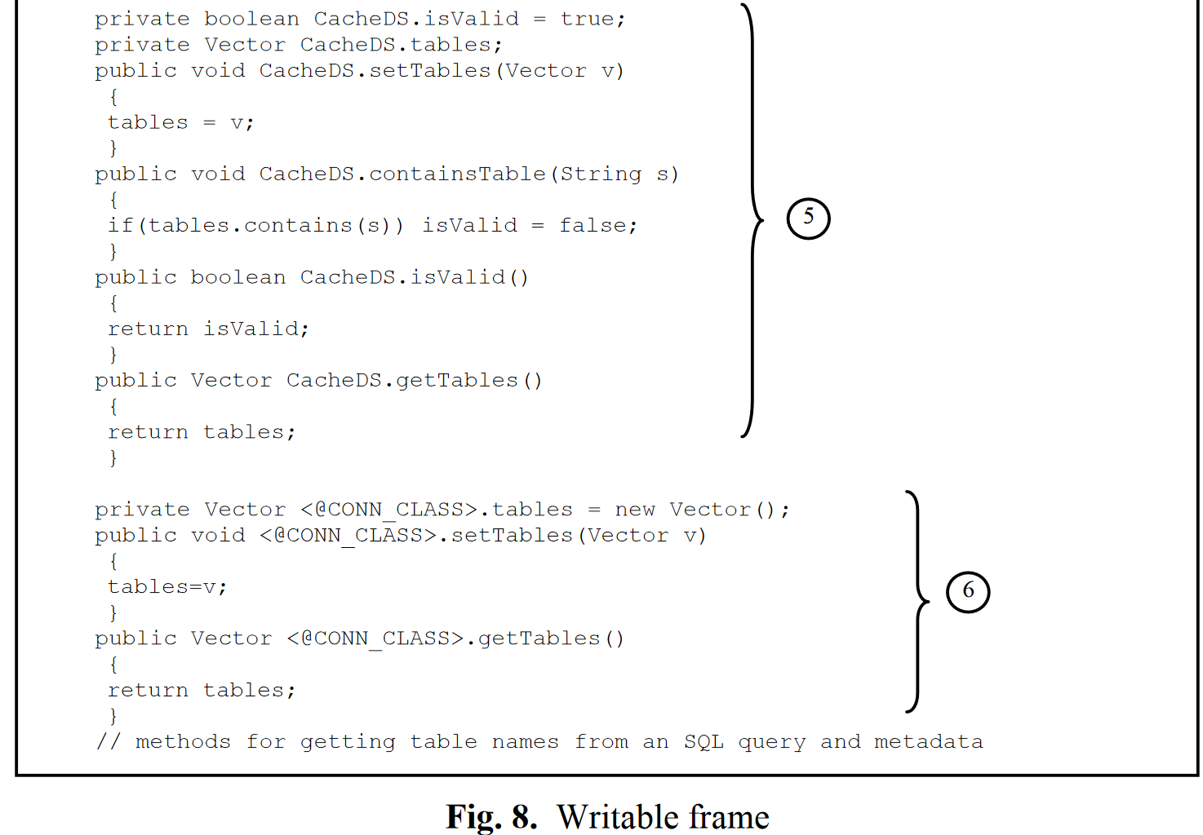
Introductions (intertype declaration) into the CacheDS data structure which
- adds new fields:
-boolean isValid
-Vector tables
and
- adds new methods:
-void setTables(Vector v)
-boolean isValid()
-void containsTable(String s)
-Vector getTables()
Loughran, N., Rashid,
A.: Framed aspects:
Supporting variability
and configurability
for AOP.
In: Proceedings of 8th
International
Conference on
Software Reuse,
ICSR 2004.
LCNS 3107, Springer,
Madrid, Spain (2004)
Class provided
as parameter
Introductions (intertype declaration) into the current CONN_CLASS to store tables for the current executing query.
Class provided as parameter

Slide 41
Specification Rules
The database cache option is selected for CACHE_TYPE, 1000 query resultsets can be stored by setting MAX_CACHE_SIZE, DELETION_SCHEME is set to the least accessed option, and PERC_TO_DEL is set to 50%.
CONN_CLASS targets a class called DBConnection, the methods for sending queries (sendQuery) to the database and sending the query results back to the client (replyToClient) are bound to SEND_QUERY and REPLY_CLIENT respectively, while the type of data to be stored in the cache, DOC_TYPE, is bound to String.
The WRITABLE option is selected and the EVERYWRITE update scheme is chosen.
Specification is processed by the composition rules defined for the cache component to bind the components together.
-separated from the main aspect code
-adaptation of framed aspects with required functionality
FINALLY, APPLYING
COMPOSITION RULES
Loughran, N., Rashid, A.: Framed aspects: Supporting variability and con-figurability for AOP. In: Proceedings of 8th International Conference onSoftware Reuse, ICSR 2004. LCNS 3107, Springer, Madrid, Spain (2004)

Slide 42
Composition Rules
Applied according to specification
-separated from the main aspect code
-creation of different rules
-reusing framed aspects in different contexts
1. Constraining meta variables to sets or ranges of possible values.
2. Adapting mandatory features as defined by the specification.
3. Adapting optional features
if selected.
4. Adaptation rules for the database cache.
Loughran, N., Rashid, A.: Framed aspects: Supporting variability and configurability
for AOP. In: Proceedings of 8th International Conference onSoftware Reuse, ICSR 2004.
LCNS 3107, Springer, Madrid, Spain (2004)

Slide 43
Checking Constraints: Example
Specification
Composition Rules
DATABASE_CACHE in [DATABASE_CACHE, WEB_CACHE]
Is constraint
Adapted
as mandatory
(always)

Slide 44
Modeling Variability - Types
A) Modeling variability using parameterization
B) Modeling variability using information hiding
C) Modeling variability using inheritance
D) Modeling variability using variation points
Source: Diana L. Webber, Hassan Gomaa, Modeling variability in software product lines with the variation point model,
Science of Computer Programming, Volume 53, Issue 3, 2004, Pages 305-331, ISSN 0167-6423, https://doi.org/10.1016/j.scico.2003.04.004
VARIATION POINT
A variation point identifies one or more locations at which the variation will occur
Source: I. Jacobson, M. Griss, P. Jonsson, Software Reuse-Architecture, Process and
Organization for Business Success, ACM Press, New York, NY, 1997

Slide 45
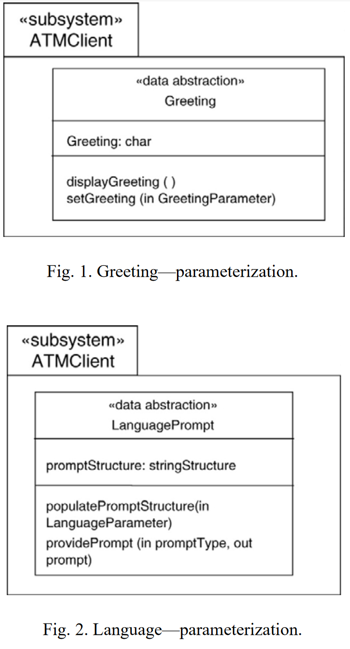
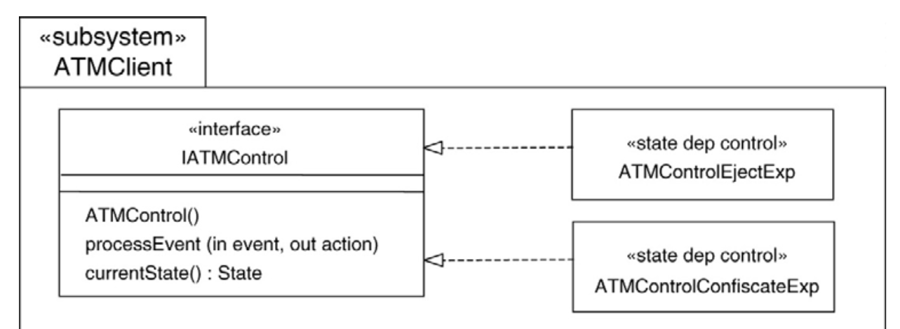
Modeling Variability Using Parameterization
The ability to vary a greeting for display.
Source: Diana L. Webber, Hassan Gomaa, Modeling variability in software product lines with the variation point model,
Science of Computer Programming, Volume 53, Issue 3, 2004, Pages 305-331, ISSN 0167-6423
-with the Unified Modeling Language (UML) notation
The ability to vary the
language of choice for display.
The ability to vary the action if the card has expired

Slide 46
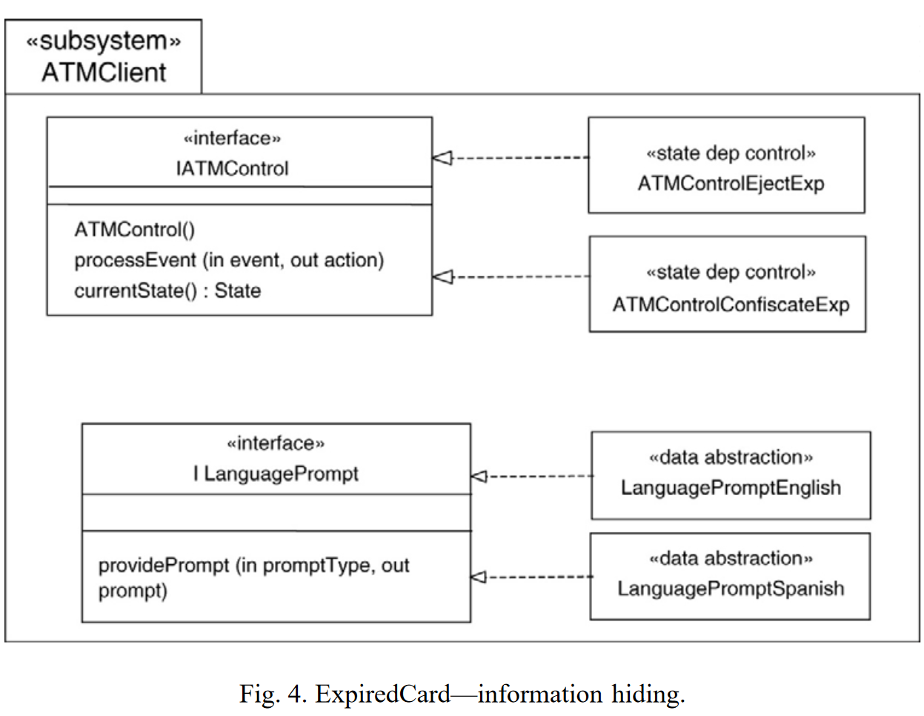
Modeling variability using information hiding
LIMITED TO SELECT FROM
THE SET OF CHOICES
-several version of the same component with the similar interface
-hiding variability inside each version of the component
VARIANTS → different versions of the same component
-limited to changes inside components,
not interfaces
-concerning component version only
-no need to develop new variants
Source: Diana L. Webber, Hassan Gomaa, Modeling variability in software product lines
with the variation point model,
Science of Computer Programming, Volume 53, Issue 3, 2004, Pages 305-331, ISSN 0167-6423

Slide 47
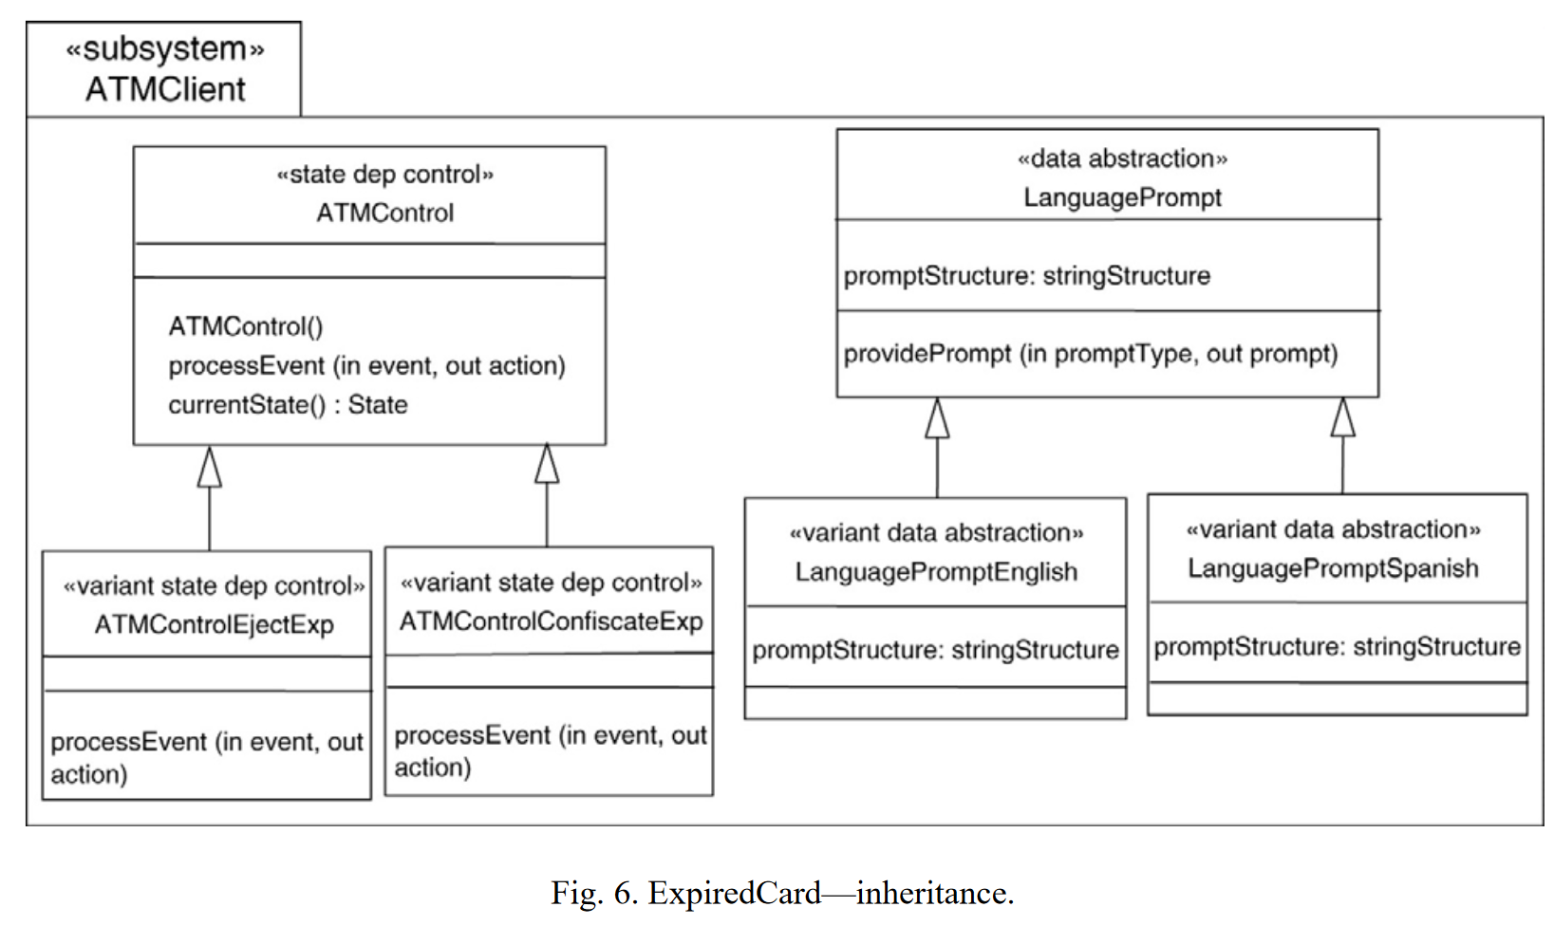
Modeling Variability Using Inheritance
Source: Diana L. Webber, Hassan Gomaa, Modeling variability in software product lines
with the variation point model,
Science of Computer Programming, Volume 53, Issue 3, 2004, Pages 305-331, ISSN 0167-6423
-variants do not have to adhere to the same interfaces
VARIANTS → specializations of other components
-subclass extends the interfaces or
superclass with provided new methods and attributes
+ overriding methods
LIMITED TO SELECT FROM
THE SET OF CHOICES
-no need to develop new variants
Example: KobrA Approach
from PULSE

Slide 48
Modeling Variability Using Variation Points
Source: Diana L. Webber, Hassan Gomaa, Modeling variability in software product lines
with the variation point model,
Science of Computer Programming, Volume 53, Issue 3, 2004, Pages 305-331, ISSN 0167-6423
-core asset component consists of variation points
USED TO BUILD TARGET SYSTEM COMPONENTS FROM VARIANTS MADE OUT OF THESE VARIATION POINTS
-the most of flexibility: making unique variants and maintaining them
PROS
CONST
-less resources to develop core assets/common core
-requires additional resources to
develop the variants as part of core assets
-reuser can create new variant not supplied with common core
-lack of reusability for reuser to create
his own variant
Communicating reuse through following views on variation points:
1) Requirements View
2) Component Variation Point View
3) Static Variation Point View
4) Dynamic Variation Point View
NEW VARIANT
CORE ASSETS
HAS TO BE ADDED INTO
-maintenance and management costs

Slide 49
Lightweight method for software product line feature management
Lightweight nature
Independent of the given programming language
No assumption about the development process or management is made
No need for specific DSL and other tools or plugins (but lacks traceability)
Managed by developers on their own, inside code specifically by annotating variable parts
Easy to comprehend and use
Only 3 associated actions given directly by annotation type – should be enough (+ another analytic versions and one recursive version can be perceived)
Expressions are not only conditional rules but domain knowledge should be inserted
Should be used in a native and modular way
The semantics of rules and derivation mechanism can be directly modified by developers according to their needs/observations

Slide 50
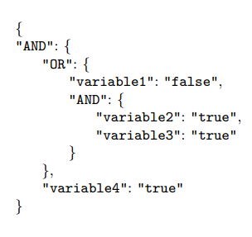
Configuration expressions
Express hierarchy information
Easy to process by other systems
Known format
Not restricted to given parser/given annotation
Addition information (non-configurational) can be included
Possibilities of IDE formatting:
Hide certain hierarchy levels
Hide whole variability information
Emphasize on certain:
Information
Variability relation

Slide 51
AND or OR JSON TREE
(variable1 OR (Variable2 AND variable3)) AND variable4
2. If given variable variable1 is false in config then
OR is true, otherwise remaining branches should be true
1. If given variables in config are both true, then
AND above is true
3. If given variable variable4 is true in config and
whole OR is true, then parent AND is true
4. If whole is true, then we can copy annotated method

Slide 52
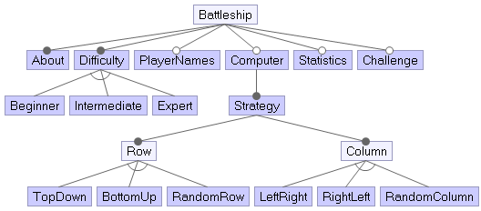
Hierarchic nature of configuration expressions
{
“AND“: {
“Statistics”: true,
“Challenge”: false,
“AND”: {
“Computer”: true,
“Row”: “RandomRow”,
“Column”: “RandomColumn”
}
}
}
Configuration
of the first later
Configuration related
to computer as player
Focus during their creation can be on:
- hierarchy levels
- feature groups
- certain hierarchies
Notes:
“

Slide 53
Applied annotations types
//@{}
//#{}
//%{}
For whole
class/aspect/interface
For class/aspect
method only
For import
statement only
Copying of whole
file with class
Copying of
given method
Copying of
given import
//@{}
//#{}
//%{}

Slide 54
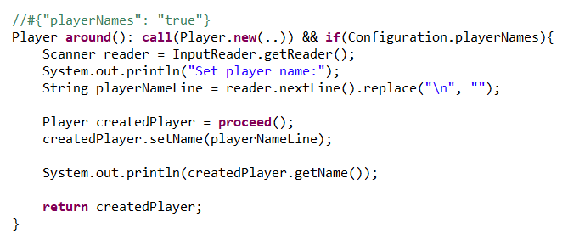
Variables features can interfere
Setting names for players needs update when computer player is added
Variable feature for
setting player names
We can’t use //@ annotation,
because of many different variable features
Method will be included only if all conditions are met (for specific feature)
Additional variable
feature for
managing also
computer name

Slide 55
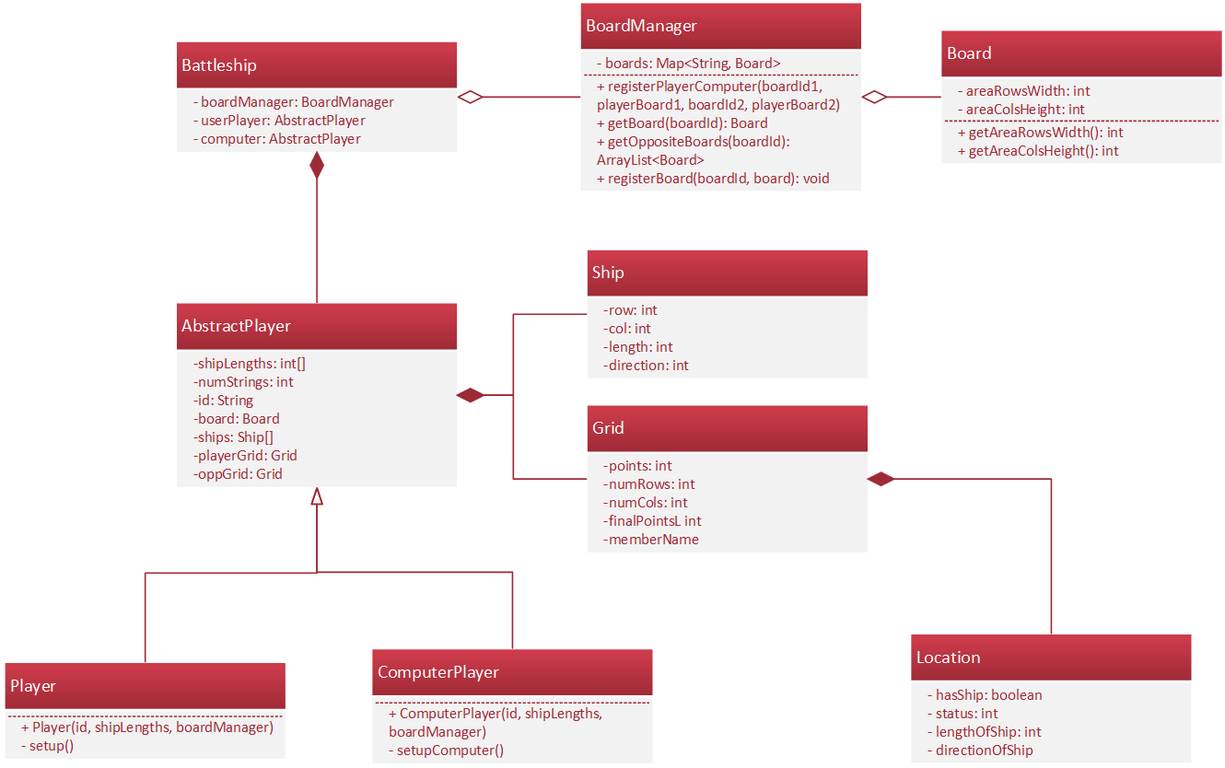
Object oriented redesign of Battleship game
Hardcoded parts should be changed to support configurability
Different lengths of board
Support for adding player
Concerns should be separated
Setup of player should be part of player class
Setup of computer should be part of computer class
Static methods should be replaced by objects
Performing
refactoring of project

Slide 56
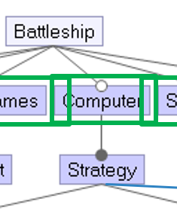
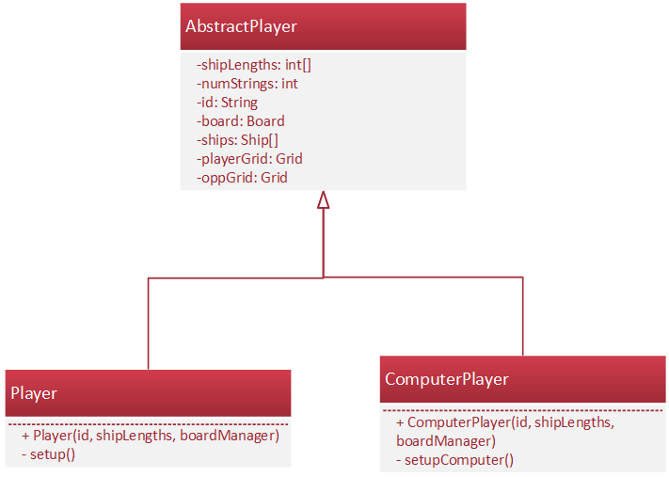
Pattern Cuckoo’s egg
Created if
condition is
met
Created by default

Slide 57
Config to feature model mapping

Slide 58
Configuration using JSON File

Slide 59
Design With Aspects as Voluntary Functionality
Aspect can be removed from execution – variable functionality
Aspect can intercepts points in execution and helps to derive product
Good to extend functionality in various ways
Add voluntary features
Choosing specific strategy from strategy options – from mandatory ones too
Enhance necessary functionality on existing classes (includes classes of additional features)

Slide 60
Applied annotations types
//@{}
//#{}
//%{}
For whole
class/aspect/interface
For class/aspect
method only
For import
statement only
Copying of whole file with class
Copying of given method
Copying of given import
//@{}
//#{}
//%{}

Slide 61
Difficulty configuration
Prepare configuration (with difficulty settings) before creating player’s specific instance
1. PREPARATION
2. POINTCUTS
The same pointcuts
(with other names)
“Hook“ functions

Slide 62
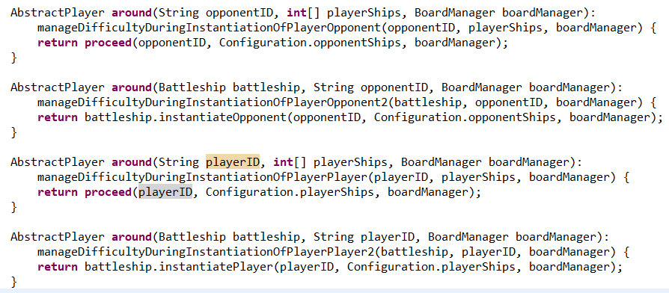
APPLYING CONFIGURATION VALUES
Calling the method with the same name but other arguments,
to apply other aspect managing player’s instance (showed previously)

Slide 63
Statistics configuration
MOVES
HITS
Statistics observation are gathered
if value of variable from config file is True
MISS = MOVES - HITS
Statistics objects are stored in hash-map

Slide 64
Variable encapsulation problem
In player instance chooser aspect:
The same problem
To call function to manage computer guess,
which should not be publicly visible

Slide 65
Derivator – Class Diagram

Slide 66
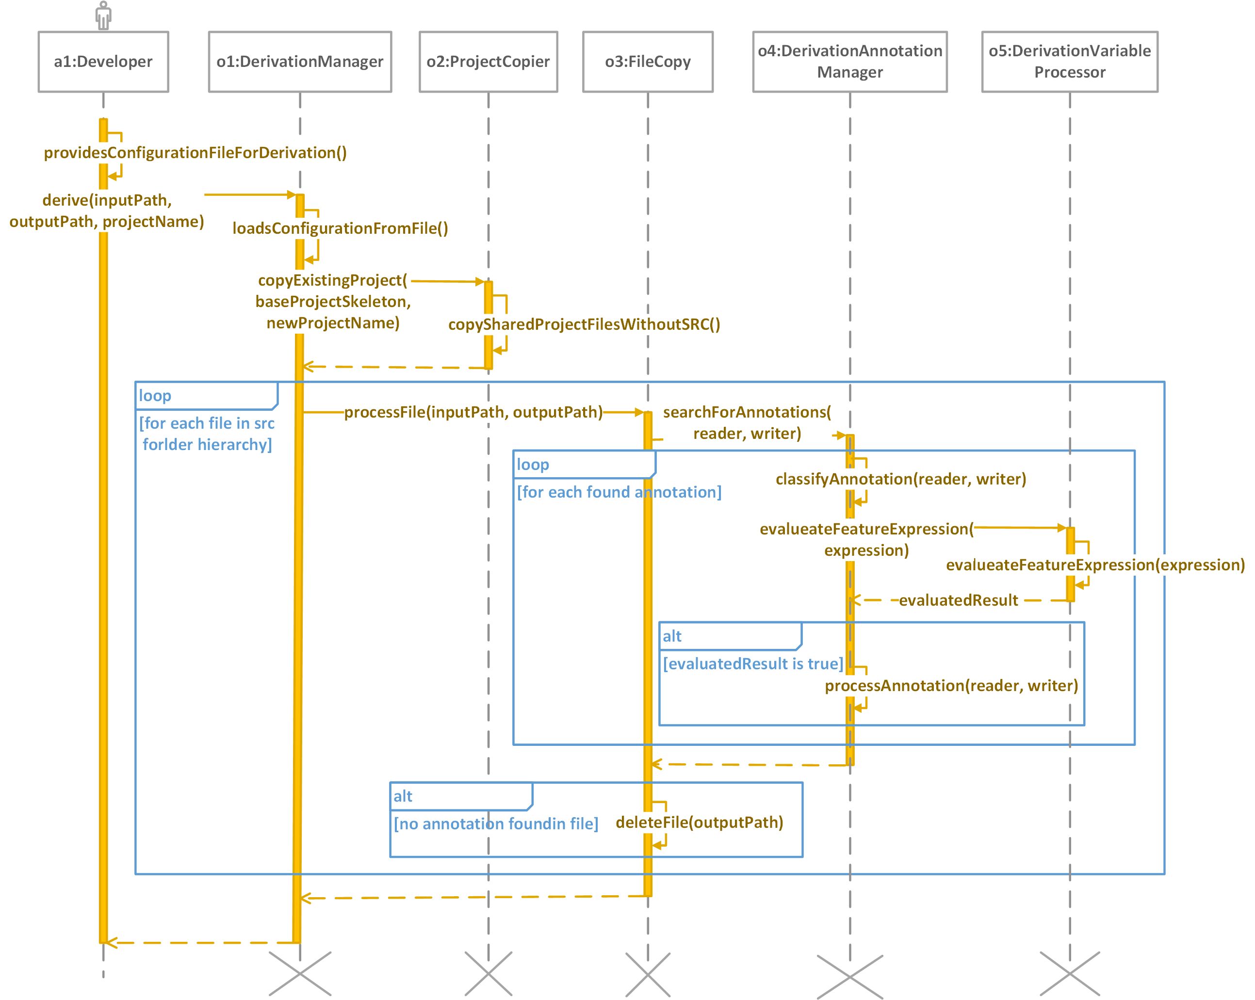
Evaluation of in-code variability

Slide 67
Motivation: Studying the complexity of in-code variability
Measure code complexity of
…to handle variability
Code constructs of variability management to handle variability
TO FIND LESS COMPLEX CODE CONSTRUCTS
TO EVALUATE INCODE EQUIVALENTS OF OUR LIGHTWEIGH METHOD CONSTRUCTS
TO DESIGN FILTERING OF VARIABILITY DEPENDENT CONTEXT
TO JUSTIFY THE SUPPORT OF LESS COMPLEX VARIABILITY CONSTRUCTS
Entire variability management
TO MEASURE THE INFLUENCE OF CODE COMPLEXITY MEASURES
Expressions used by variability management to mark variability
TO OPTIMIZE THEM
TO MAKE THEM MORE COMPREHENSIBLE WHILE PRESERVING FEATURE MODELS IN CODE

Slide 68
Measuring in-code complexity of puzzle
to play SPL
5 features
76 files, 84 classes
64 unique classes
Wilcoxon pair test
- 0,05 significance level
independent on
distribution

Slide 69
Commonality
vs. Variability
Puzzle app.
vs.
Desing app.

Slide 70
Cases to evaluate in-code complexity
Case 1: Variability is expressed using detachable decorators
Case 2: Variability is expressed using detachable decorators, but without variability configuration expressions
Case 3: Variability is expressed using wrappers
Case 4: Variability is not expressed at all
Case 5: Variability is expressed using detachable decorators, but additional unwanted dead code constructs are not included for illegal decorators

Slide 71
// @ts-ignore
@DecoratorTypesService.skipLineVariableDeclaration(
{"OR": { "zoomCoordinates": "true", "zoomValue": "true" }}, "[NOT=let zoomConfig = null;]")
let zoomConfig = {"name": "Zoom", "path": "/puzzle/zoom",
"componentPathInModule": "zoom", "componentRef": ZoomManagementComponent};
VS
EXPRESSION_START50 = {"OR": { "zoomCoordinates": "true", "zoomValue": "true" }};
let zoomConfig = {"name": "Zoom", "path": "/puzzle/zoom",
"componentPathInModule": "zoom", "componentRef": ZoomManagementComponent};
ELSE50 = { "ELSE": "~~~~~~~~~~~~~~~~~~~~~~~~~" };
let zoomConfig = null;
EXPRESSION_END50 = { "EXPRESSION_END": "---------------------------" };

Slide 72
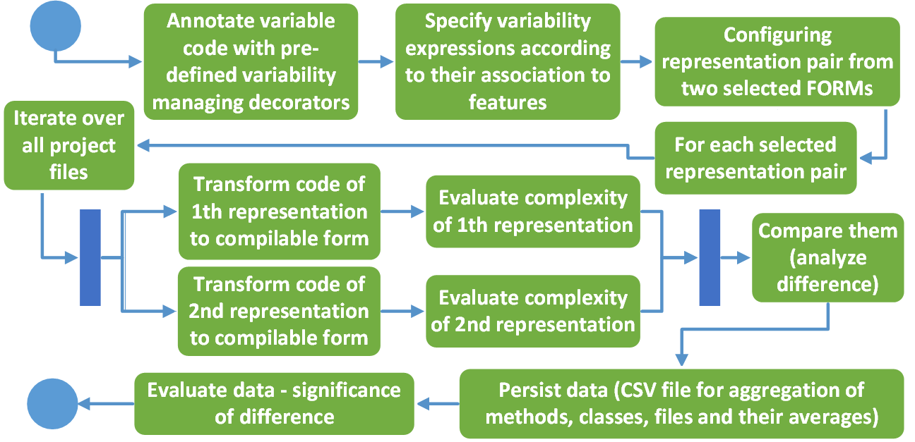
Evaluation process

Slide 73
How complex configuration expression are?
Hypothesis 1: Variability expressions extracted from annotations do not significantly change the complexities of most evaluated metrics.

Slide 74
Configuration expressions
Express hierarchy information
Easy to process by other systems
Known format
Not restricted to given parser/given annotation
Addition information (non-configurational) can be included
Possibilities of IDE formatting:
Hide certain hierarchy levels
Hide whole variability information
Emphasize on certain:
Information
Variability relation

Slide 75
Hierarchic nature of configuration expressions
{
“AND“: {
“Statistics”: true,
“Challenge”: false,
“AND”: {
“Computer”: true,
“Row”: “RandomRow”,
“Column”: “RandomColumn”
}
}
}
Configuration
of the first later
Configuration related
to computer as player
Focus during their creation can be on:
- hierarchy levels
- feature groups
- certain hierarchies
Notes:
“

Slide 76
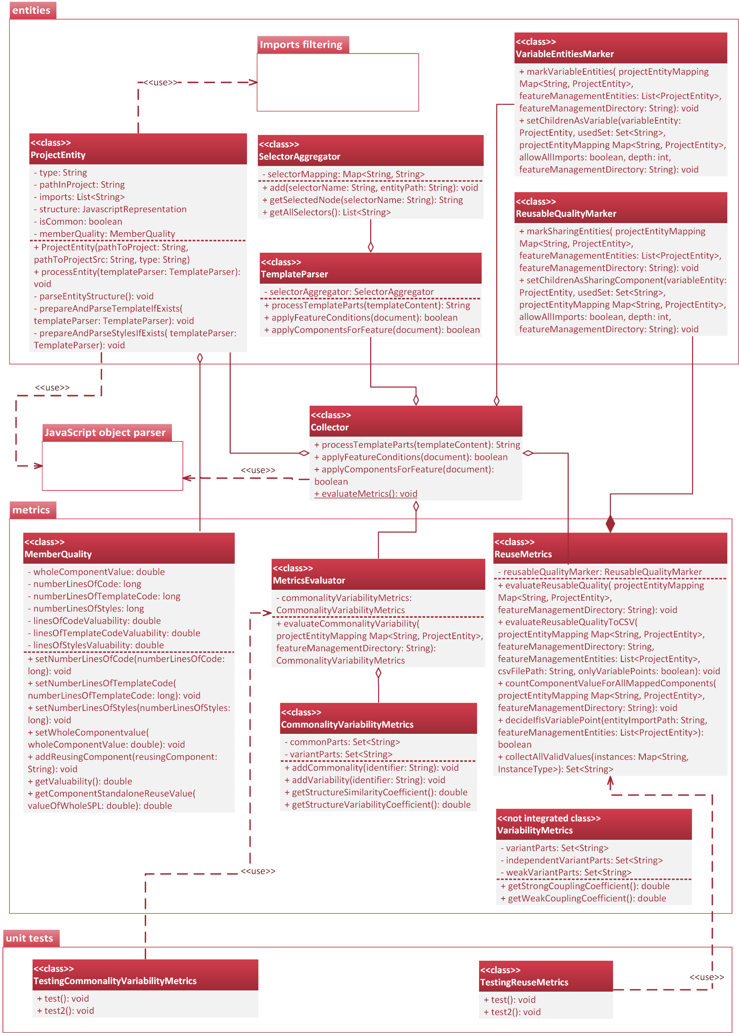

Slide 79
Analogies
…towards code comprehension
The reason for using the Halstead measures in this study
is given by the increase in cognitive processing
demands due to the number of symbols.
Schuster, S., Hawelka, S., Himmelstoss, N.A., Richlan, F., Hutzler, F.:
The neural correlates of word position and lexical predictability during
sentence reading: Evidence from fixation-related fMRI. Language,
Cognition and Neuroscience 35(5), 613–624 (Jun 2020)
The cyclomatic complexity was used to
analyze control flows due to their effects
on rule-guided conditional reasoning.
No difference
in cyclomatic
complexity
Annotations with variability
expressions should be
part of execution flow
Kulakova, E., Aichhorn, M., Schurz, M., Kronbichler, M., Perner, J.:
Processing counterfactual and hypothetical conditionals:
An fMRI investigation. NeuroImage 72, 265–271 (May 2013)

Slide 80
Hierarchically expressed configuration expressions brings significant complexity.
Their code complexity can be used to optimize
them for example in automatic evolution process.

Slide 81
Are traditional wrappers more
complex than decorators?
Hypothesis 2: Changing from wrappers to decorators significantly improves the complexity of most evaluated complexity metrics.

Slide 82
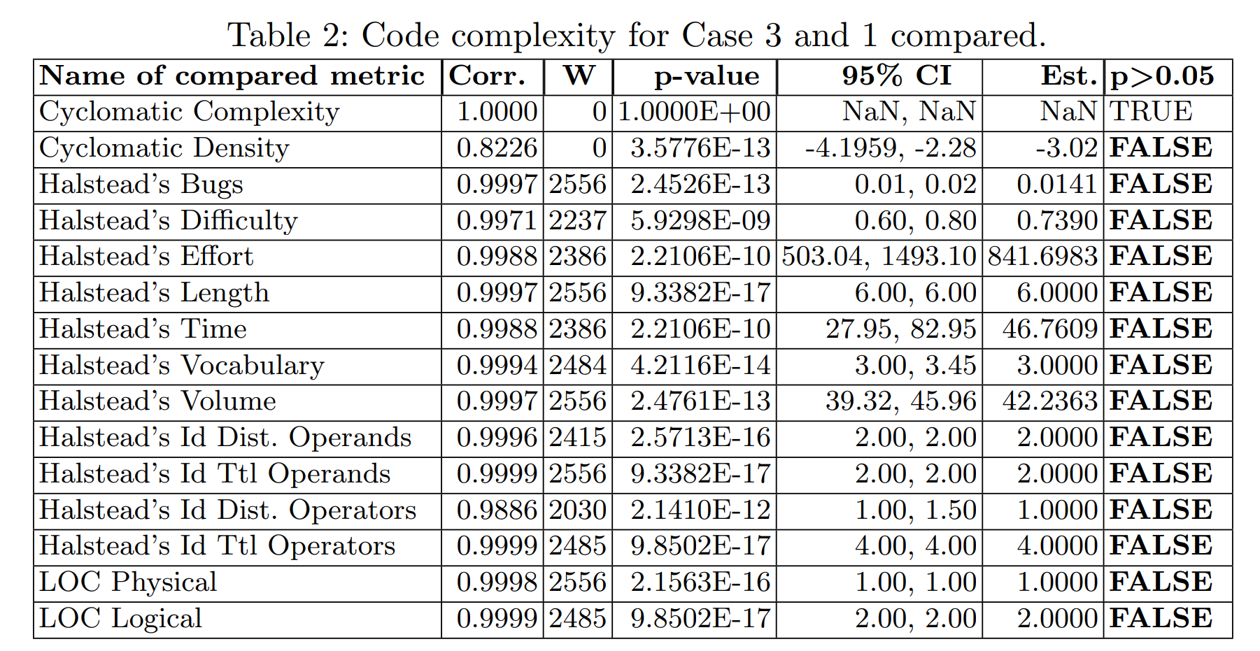

Slide 83
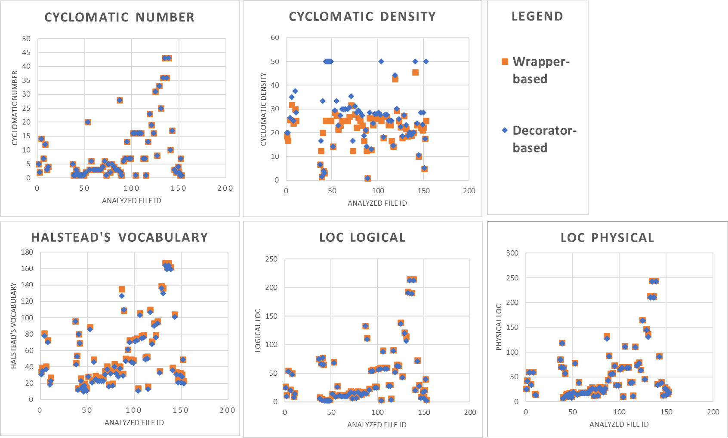

Slide 85
Decorators are significantly less complex than wrappers even for a few variable features.
Conventional solutions based on wrappers such
as pure::variants or conditional compilation
can be enhanced to managing features in code.

Slide 86
Is complexity of variability management significant
for used code complexity measures?
…is less complex decorator-detachable version
insignificant to most of code-complexity measures?
Hypothesis 3: Removal of all variability constructs from Case 1 does not significantly change at least one of the evaluated complexity metrics.

Slide 90
The code complexity change after removal of files with most of (unconvertable decorators into) wrappers
Narrowing test focused
on already supported
decorators in TypeScript

Slide 92
The variability management significantly influences the code complexity
…the annotated code of fragments of variable features
should be filtered according to
particular manipulations with code to decrease it

Slide 93
Is dead code introduced with use of
illegal decorators in TypeScript significant for
used code complexity measures?
…should some of illegal decorators by supported in future
version for variability management?
Hypothesis 4: Unwanted dead code constructs significantly change complexity measured by most evaluated complexity metrics.

Slide 97
The support of function and import decorators is necessary to reduce dead code with borderline but still significant impact on code complexity.

Slide 98
Future work
Optimizing configuration expressions on fractals where variability is modeled and managed in large (many features)
To suit interacting features
To suit features on the same layer
To suit features on a particular hierarchy tree
combinations of approaches above
Introducing variability filtering according to features, concerns, and code complexity
Observing a variability-oriented cyclomatic number by introducing program flow that directly contains variability conditions taken from configuration expressions
Evaluate other code complexity measures and observe their influence on user cognitive processing and comprehension

Slide 99
Optimalization of configuration expressions in large
…creating hierarchic structures and evaluating
the comprehension of feature models in code
via automated software
product line evolution focused
on generating fractal shapes

Slide 101
Bibliography
BEUCHE, Danilo a Mark DALGARNO, 2006. Software Product Line Engineering with Feature Models. 2006, s. 7.
BOTTERWECK, Goetz, Kwanwoo LEE a Steffen THIEL, 2009. Automating Product Derivation in Software Product Line Engineering. 2009, s. 6.
KASTNER, Christian, Sven APEL a Don BATORY, 2007. A Case Study Implementing Features Using AspectJ. V: 11th International Software Product Line Conference (SPLC 2007): 11th International Software Product Line Conference (SPLC 2007) [online]. Kyoto, Japan: IEEE, s. 223–232 [cit. 30.9.2021]. ISBN 978-0-7695-2888-5. Dostupné na: doi:10.1109/SPLINE.2007.12
LADDAD, Ramnivas, 2003. AspectJ in action: practical aspect-oriented programming. Greenwich, CT: Manning. ISBN 978-1-930110-93-9.
PELÁNEK, Radek, 2012. Programátorská cvičebnice. 1. vydání. Brno: Computer press. ISBN 978-80-251-3751-2.
VRANIC, Valentino a Roman TÁBORSKÝ, 2016. Features as transformations: A generative approach to software development. Computer Science and Information Systems [online]. 2016, roč. 13, č. 3, s. 759–778. ISSN 1820-0214, 2406-1018. Dostupné na: doi:10.2298/CSIS160128027V
YOUNG, Trevor J a B MATH, 1999. Using AspectJ to Build a Software Product Line for Mobile Devices. 1999, s. 73.

Slide 102
Mohammad Abu-Matar and Hassan Gomaa. 2011. Variability Modeling for Service Oriented Product Line Architectures. In 2011 15th International Software Product Line Conference. IEEE, Munich, Germany, 110–119. https://doi.org/10.1109/ SPLC.2011.26
Hwi Ahn and Sungwon Kang. 2011. Analysis of Software Product Line Architecture Representation Mechanisms. In 2011 Ninth International Conference on Software Engineering Research, Management and Applications. IEEE, Baltimore, MD, USA, 219–226. https://doi.org/10.1109/SERA.2011.22
S.A. Ajila. 2005. Reusing Base-product Features to develop Product Line Architecture. In IRI -2005 IEEE International Conference on Information Reuse and Integration, Conf, 2005. IEEE, Las Vegas, NV, USA, 288–293. https://doi.org/10.1109/ IRI-05.2005.1506488
Samuel A Ajila and Patrick J Tierney. 2002. The FOOM Method – Modeling Software Product Lines in Industrial Settings. (2002), 11.
Vander Alves, Pedro Matos Jr, and Paulo Borba. 2004. An Incremental Aspect-Oriented Product Line Method for J2ME Game Development. (2004), 3.
Vander Alves, Pedro Matos, Leonardo Cole, Alexandre Vasconcelos, Paulo Borba, and Geber Ramalho. 2007. Extracting and Evolving Code in Product Lines with Aspect-Oriented Programming. In Transactions on Aspect-Oriented Software Development IV, David Hutchison, Takeo Kanade, Josef Kittler, Jon M. Kleinberg, Friedemann Mattern, John C. Mitchell, Moni Naor, Oscar Nierstrasz, C. Pandu Rangan, Bernhard Steffen, Madhu Sudan, Demetri Terzopoulos, Doug Tygar, Moshe Y. Vardi, Gerhard Weikum, Awais Rashid, and Mehmet Aksit (Eds.). Vol. 4640. Springer Berlin Heidelberg, Berlin, Heidelberg, 117–142. https://doi.org/10.1007/978-3-540-77042-8_5 Series Title: Lecture Notes in Computer Science.

Slide 103
Fazal-e Amin, Ahmad Kamil Mahmood, and Alan Oxley. 2010. A Review on Aspect Oriented Implementation of Software Product Lines Components. Information Technology Journal 9, 6 (Aug. 2010), 1262–1269. https://doi.org/10.3923/itj.2010. 1262.1269
Michalis Anastasopoulos and Dirk Muthig. 2004. An Evaluation of Aspect-Oriented Programming as a Product Line Implementation Technology. In Software Reuse: Methods, Techniques, and Tools, Jan Bosch and Charles Krueger (Eds.). Vol. 3107. Springer Berlin Heidelberg, Berlin, Heidelberg, 141–156. https://doi.org/10.1007/978-3-540-27799-6_12 Series Title: Lecture Notes in Computer Science
Sven Apel, Thomas Leich, and Gunter Saake. 2006. Aspectual mixin layers: aspects and features in concert. In Proceedings of the 28th international conference on Software engineering. ACM, Shanghai China, 122–131. https://doi.org/10.1145/ 1134285.1134304
U. Aßmann. 2003. Invasive Software Composition. Springer-Verlag, Berlin, Heidelberg
M.A. Babar. 2004. Scenarios, Quality Attributes, and Patterns: Capturing and Using their Synergistic Relationships for Product Line Architectures. In 11th Asia-Pacific Software Engineering Conference. IEEE, Busan, Korea, 574–578. https: //doi.org/10.1109/APSEC.2004.91
Felix Bachmann and Len Bass. 2001. Managing Variability in Software Architectures. (2001), 7.
L. Balzerani, D. Di Ruscio, A. Pierantonio, and G. De Angelis. 2005. A product line architecture for web applications. In Proceedings of the 2005 ACM symposium on Applied computing - SAC ’05. ACM Press, Santa Fe, New Mexico, 1689. https://doi.org/10.1145/1066677.1067059

Slide 104
Gérald Barré. 2018. Aspect Oriented Programming in TypeScript. https://www.meziantou.net/aspect-oriented-programmingin-typescript.htm
Don Batory, Rich Cardone, and Yannis Smaragdakis. 2000. Object-Oriented Frameworks and Product Lines. In Software Product Lines, Patrick Donohoe (Ed.). Springer US, Boston, MA, 227–247. https://doi.org/10.1007/978-1-4615-4339-8_13
Joachim Bayer, Oliver Flege, and Cristina Gacek. 2000. Creating Product Line Architectures. In Software Architectures for Product Families, Gerhard Goos, Juris Hartmanis, Jan van Leeuwen, and Frank van der Linden (Eds.). Vol. 1951. Springer Berlin Heidelberg, Berlin, Heidelberg, 210–216. https://doi.org/10.1007/978-3-540-44542-5_23 Series Title: Lecture Notes in Computer Science.
Ivo Augusto Bertoncello, Marcelo Oliveira Dias, Patrick H. S. Brito, and Cecília M. F. Rubira. 2008. Explicit exception handling variability in component-based product line architectures. In Proceedings of the 4th international workshop on Exception handling - WEH ’08. ACM Press, Atlanta, Georgia, 47–54. https://doi.org/10.1145/1454268.1454275
Vinicius Bischoff, Kleinner Farias, Lucian José Gonçales, and Jorge Luis Victória Barbosa. 2019. Integration of feature models: A systematic mapping study. Information and Software Technology 105 (Jan. 2019), 209–225. https://doi.org/10. 1016/j.infsof.2018.08.016
Lynne Blair and Jianxiong Pang. 2003. Aspect-Oriented Solutions to Feature Interaction Concerns using AspectJ. (2003), 17.
Jan Bosch. 2000. Design & Use of Software Architectures—Adopting and Evolving a Product Line Approach.

Slide 105
Jan Bosch, Gert Florijn, Danny Greefhorst, Juha Kuusela, J. Henk Obbink, and Klaus Pohl. 2002. Variability Issues in Software Product Lines. In Software Product-Family Engineering, Gerhard Goos, Juris Hartmanis, Jan van Leeuwen, and Frank van der Linden (Eds.). Vol. 2290. Springer Berlin Heidelberg, Berlin, Heidelberg, 13–21. https://doi.org/10.1007/3-540-47833-7_3 Series Title: Lecture Notes in Computer Science
Jonathan Cardoso. 2021. How To Use Decorators in TypeScript. https://www.digitalocean.com/community/tutorials/howto-use-decorators-in-typescript
João M.P. Cardoso, Tiago Carvalho, José G.F. Coutinho, Wayne Luk, Ricardo Nobre, Pedro Diniz, and Zlatko Petrov. 2012. LARA: an aspect-oriented programming language for embedded systems. In Proceedings of the 11th annual international conference on Aspect-oriented Software Development - AOSD ’12. ACM Press, Potsdam, Germany, 179. https://doi.org/10.1145/2162049.2162071
Adrian Colyer, Awais Rashid, and Gordon Blair. 2004. On the Separation of Concerns in Program Families. (2004), 11
Tung M. Dao and Kyo C. Kang. 2010. Mapping Features to Reusable Components: A Problem Frames-Based Approach. In Software Product Lines: Going Beyond, David Hutchison, Takeo Kanade, Josef Kittler, Jon M. Kleinberg, Friedemann Mattern, John C. Mitchell, Moni Naor, Oscar Nierstrasz, C. Pandu Rangan, Bernhard Steffen, Madhu Sudan, Demetri Terzopoulos, Doug Tygar, Moshe Y. Vardi, Gerhard Weikum, Jan Bosch, and Jaejoon Lee (Eds.). Vol. 6287. Springer Berlin Heidelberg, Berlin, Heidelberg, 377–392. https://doi.org/10.1007/978-3-642-15579-6_26 Series Title: Lecture Notes in Computer Science.
Ebru Dincel, Nenad Medvidovic, and André van der Hoek. 2002. Measuring Product Line Architectures. In Software Product-Family Engineering, Gerhard Goos, Juris Hartmanis, Jan van Leeuwen, and Frank van der Linden (Eds.). Vol. 2290. Springer Berlin Heidelberg, Berlin, Heidelberg, 346–352. https://doi.org/10.1007/3-540-47833-7_31 Series Title: Lecture Notes in Computer Science.
Chethana Kuloor Armin Eberlein. 2002. Requirements Engineering for Software Product Lines. (2002), 12

Slide 106
Eun Sook Cho, Min Sun Kim, and Soo Dong Kim. 2001. Component metrics to measure component quality. In Proceedings Eighth Asia-Pacific Software Engineering Conference. IEEE Comput. Soc, Macao, China, 419–426. https://doi.org/10.1109/ APSEC.2001.991509
Eduardo Figueiredo, Nelio Cacho, Claudio Sant’Anna, Mario Monteiro, Uira Kulesza, Alessandro Garcia, Sergio Soares, Fabiano Ferrari, Safoora Khan, Fernando Castor Filho, and Francisco Dantas. 2008. Evolving Software Product Lines with Aspects: An Empirical Study on Design Stability. (2008), 10.
Robert E. Filman and Daniel P. Friedman. 2000. Aspect-Oriented Programming is Quantification and Obliviousness. In Proceedings of the Workshop on Advanced Separation of Concerns in Object-Oriented Systems, ACM Conference on ObjectOriented Programming, Systems, Languages, and Applications, OOPSLA 2000. Minneapolis, Minnesota USA. RIACS Technical Report 01.12, 2001.
Critina Gacek and Michalis Anastasopoules. 2001. Implementing product line variabilities. In Proceedings of the 2001 symposium on Software reusability putting software reuse in context - SSR ’01. ACM Press, Toronto, Ontario, Canada, 109–117. https://doi.org/10.1145/375212.375269
R.L. Glass and I. Vessey. 1998. Focusing on the application domain: everyone agrees it’s vital, but who’s doing anything about it?. In Proceedings of the Thirty-First Hawaii International Conference on System Sciences, Vol. 3. IEEE Comput. Soc, Kohala Coast, HI, USA, 187–196. https://doi.org/10.1109/HICSS.1998.656141
Sebastian Gunther and Thorsten Berger. 2008. Service-Oriented Product Lines: Towards a Development Process and Feature Management Model for Web Services. (2008), 6.
Stefan Hanenberg, Christian Oberschulte, and Rainer Unland. 2003. Refactoring of Aspect-Oriented Software. (2003), 18.

Slide 107
Jan Hannemann and Gregor Kiczales. 2002. Design Pattern Implementation in Java and AspectJ. (Nov. 2002), 13.
Wenhao Huang, Chengwan He, and Zheng Li. 2015. A Comparison of Implementations for Aspect-Oriented JavaScript:. Zhengzhou, China. https://doi.org/10.2991/csic-15.2015.9
Renien John Joseph. 2015. Single Page Application and Canvas Drawing. International journal of Web & Semantic Technology 6, 1 (Jan. 2015), 29–37. https://doi.org/10.5121/ijwest.2015.6103
Critina Gacek and Michalis Anastasopoules. 2001. Implementing product line variabilities. In Proceedings of the 2001 symposium on Software reusability putting software reuse in context - SSR ’01. ACM Press, Toronto, Ontario, Canada, 109–117. https://doi.org/10.1145/375212.375269
K. C. Kang, S. G. Cohen, J. A. Hess, W. E. Novak, and A. S. Peterson. 1990. Feature-Oriented Domain Analysis (FODA) Feasibility Study. Technical Report. Carnegie-Mellon University Software Engineering Institute
Christian Kastner, Sven Apel, and Don Batory. 2007. A Case Study Implementing Features Using AspectJ. In 11th International Software Product Line Conference (SPLC 2007). IEEE, Kyoto, Japan, 223–232. https://doi.org/10.1109/SPLINE.2007.12
Elizabeth A Kendall. 1999. Role Model Designs and Implementations with Aspect-oriented Programming. (1999), 17

Slide 108
Gregor Kiczales, Erik Hilsdale, Jim Hugunin, Mik Kersten, Jeffrey Palm, and William G. Griswold. 2001. An Overview of AspectJ. In ECOOP 2001 — Object-Oriented Programming, Gerhard Goos, Juris Hartmanis, Jan van Leeuwen, and Jørgen Lindskov Knudsen (Eds.). Vol. 2072. Springer Berlin Heidelberg, Berlin, Heidelberg, 327–354. https://doi.org/10. 1007/3-540-45337-7_18 Series Title: Lecture Notes in Computer Science.
Jan Kohut and Valentino Vranic. 2010. Guidelines for using aspects in product lines. In 2010 IEEE 8th International Symposium on Applied Machine Intelligence and Informatics (SAMI). IEEE, Herlany, 183–188. https://doi.org/10.1109/SAMI.2010. 5423741

